Slide 1
Techniques of proof Proving universal / Existential statements true or false Direct and indirect proof strategies

Slide 2
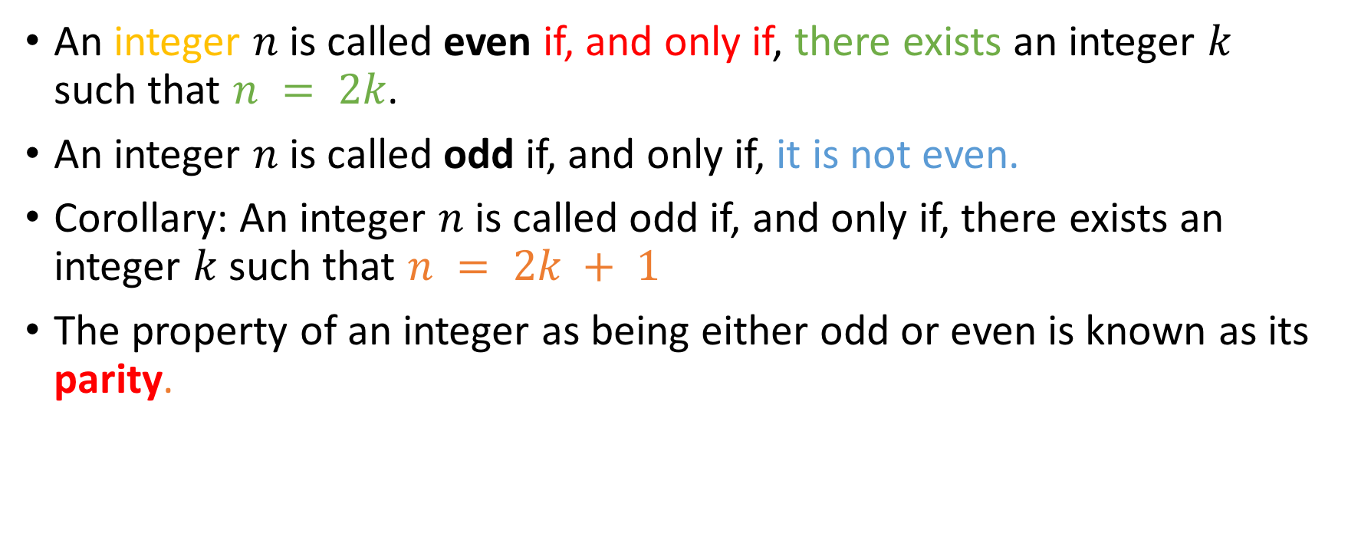
Basic definitions:Parity
An integer $n$ is called even if, and only if, there exists an integer $k$ such that $n = 2k$.
An integer $n$ is called odd if, and only if, it is not even.
Corollary: An integer $n$ is called odd if, and only if, there exists an integer $k$ such that $n = 2k + 1$
The property of an integer as being either odd or even is known as its parity.

Slide 3
Arguing the positive: Universal Statements
Let’s consider the following statement:
“The sum of an odd and an even integer is odd.”

Slide 4
Arguing the positive: Universal Statements
Let’s consider the following statement:
“The sum of an odd and an even integer is odd.”
Do you believe this statement?
Yes
No

Slide 5
Arguing the positive: Universal Statements
Let’s consider the following statement:
“The sum of an odd and an even integer is odd.”
Do you believe this statement?
If you believe it, you have to try to prove that it’s true (argue the positive/affirmative)
Yes
No

Slide 6
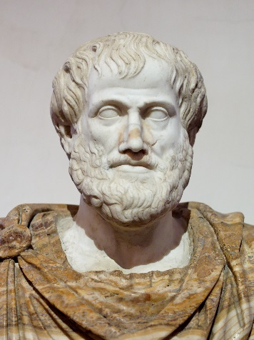
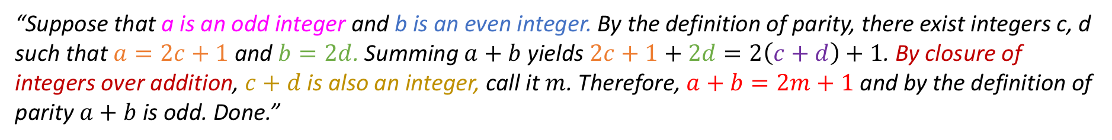
Proof, verbal style
“Suppose that a is an odd integer and b is an even integer. By the definition of parity, there exist integers c, d such that $a=2c+1$ and $b=2d$. Summing $a+b$ yields $2c+1+2d=2\left(c+d\right)+1$. By closure of integers over addition, $c+d$ is also an integer, call it $m$. Therefore, $a+b=2m+1$ and by the definition of parity $a+b$ is odd. Done.”

Slide 7
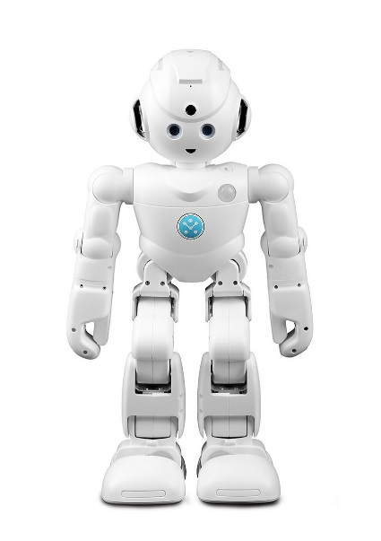
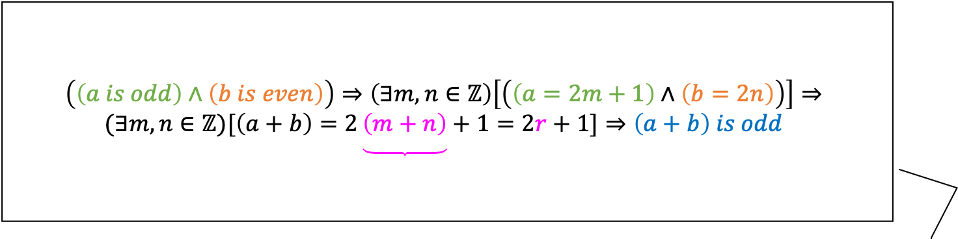

Proof, symbolic style
$$\left(\left(a is odd\right)∧\left(b is even\right)\right)⇒\left(∃m, n∈ℤ\right)\left[\left(\left(a=2m+1\right)∧\left(b=2n\right)\right)\right]⇒$$
$$(∃m, n∈ℤ)[\left(a+b\right)=2\underbrace{\left(m+n\right)}+1=2r+1]⇒\left(a+b\right) is odd$$
$r∈$ $ℤ$ by closure

Slide 8
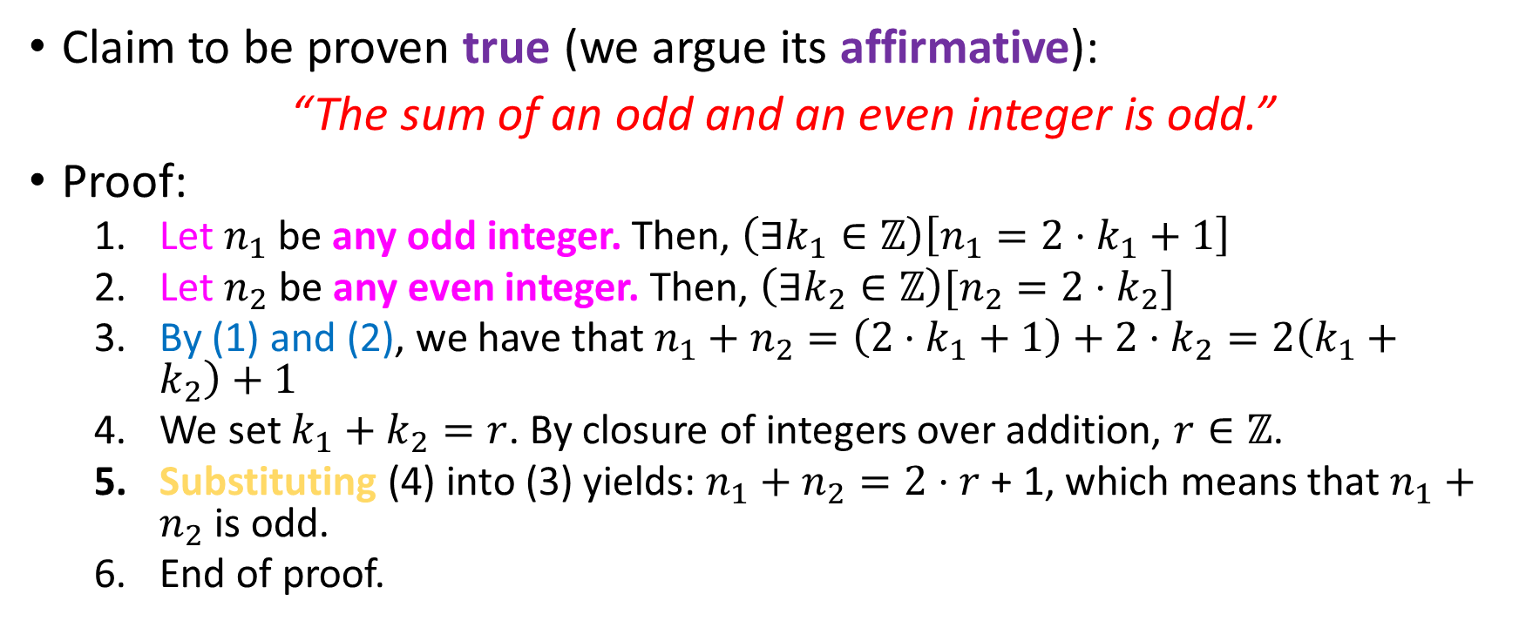
Proof, mixed
Claim to be proven true (we argue its affirmative):
“The sum of an odd and an even integer is odd.”
Proof:
Let $n_{1}$ be any odd integer. Then, $\left(∃k_{1}∈ℤ\right)\left[n_{1}=2⋅k_{1}+1\right]$
Let $n_{2}$ be any even integer. Then, ${\left(∃k_{2}∈ℤ\right)[n}_{2}=2⋅k_{2}]$
By (1) and (2), we have that $n_{1}+n_{2}=\left(2⋅k_{1}+1\right)+2⋅k_{2}=2\left(k_{1}+k_{2}\right)+1$
We set $k_{1}+k_{2}=r$. By closure of integers over addition, $r∈ℤ$.
Substituting (4) into (3) yields: $n_{1}+n_{2}=2⋅r$ + 1, which means that $n_{1}+n_{2}$ is odd.
End of proof.

Slide 9
Here’s some more!
Let’s prove the following claims true:
The square of an odd integer is also odd.

Slide 10
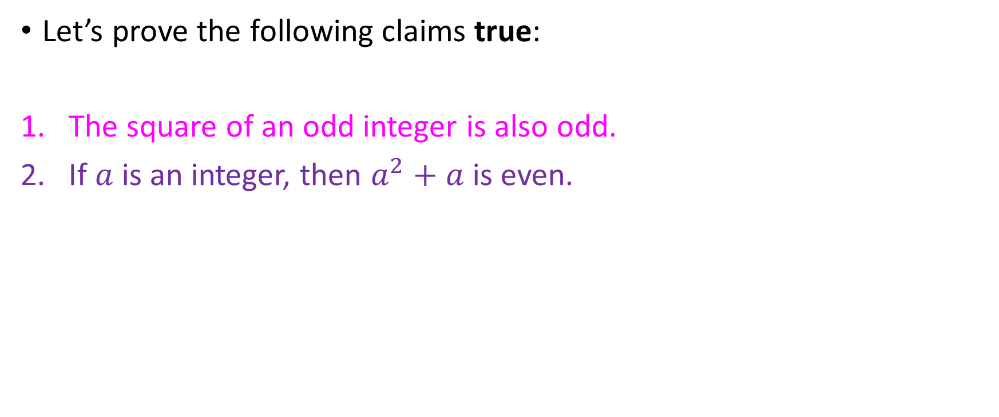
Here’s some more!
Let’s prove the following claims true:
The square of an odd integer is also odd.
If $a$ is an integer, then $a^{2}+a$ is even.

Slide 11
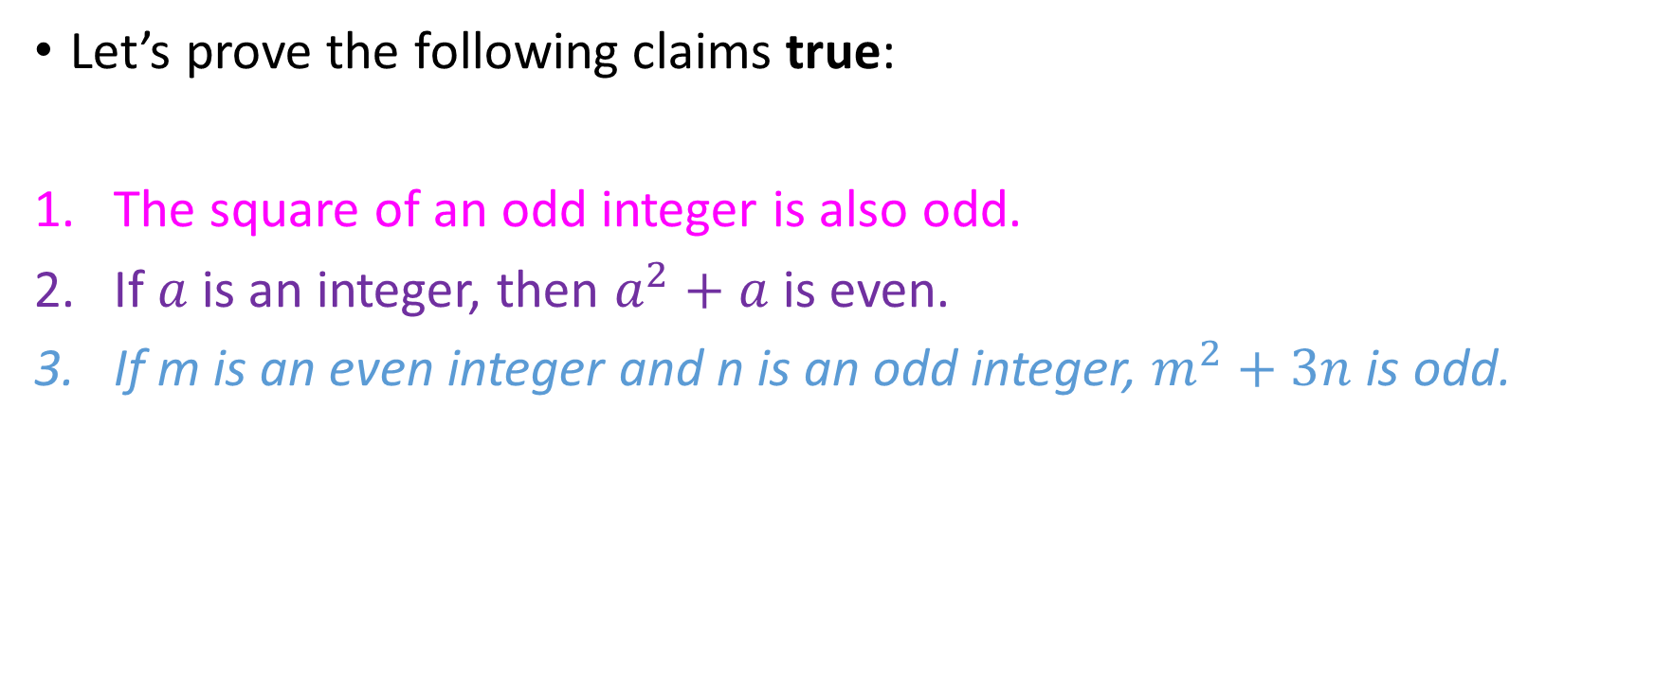
Here’s some more!
Let’s prove the following claims true:
The square of an odd integer is also odd.
If $a$ is an integer, then $a^{2}+a$ is even.
If m is an even integer and n is an odd integer, $m^{2}+3n$ is odd.

Slide 12
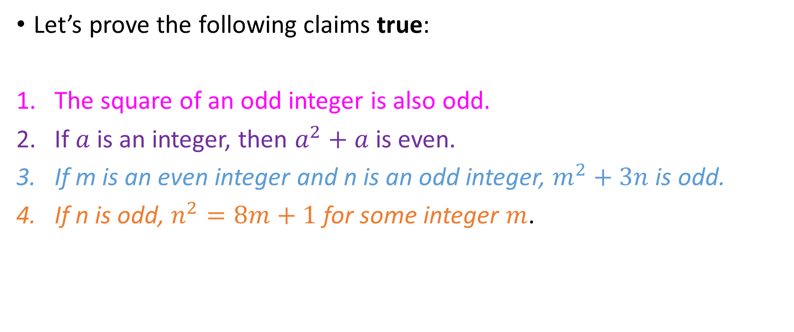
Here’s some more!
Let’s prove the following claims true:
The square of an odd integer is also odd.
If $a$ is an integer, then $a^{2}+a$ is even.
If m is an even integer and n is an odd integer, $m^{2}+3n$ is odd.
If n is odd, $n^{2}=8m+1$ for some integer $m$.

Slide 13
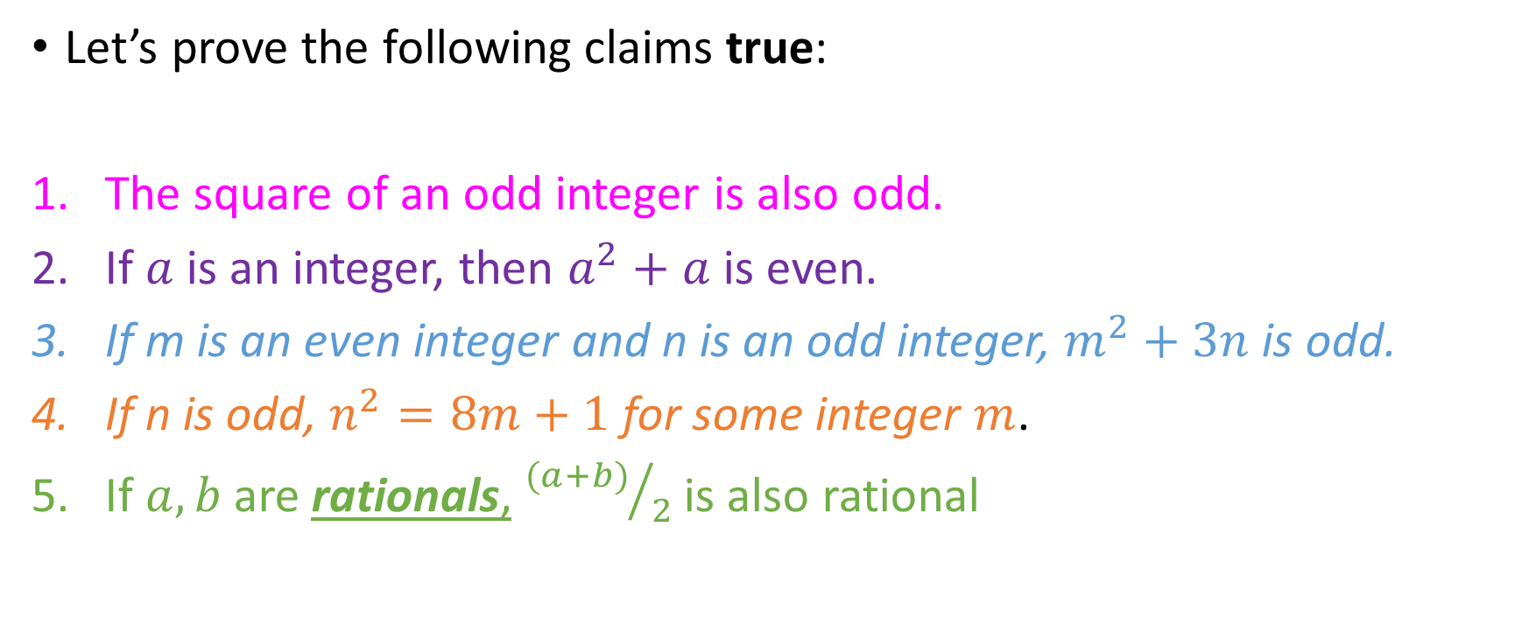
Here’s some more!
Let’s prove the following claims true:
The square of an odd integer is also odd.
If $a$ is an integer, then $a^{2}+a$ is even.
If m is an even integer and n is an odd integer, $m^{2}+3n$ is odd.
If n is odd, $n^{2}=8m+1$ for some integer $m$.
If $a, b$ are rationals, ${(a+b)}/2$ is also rational

Slide 14
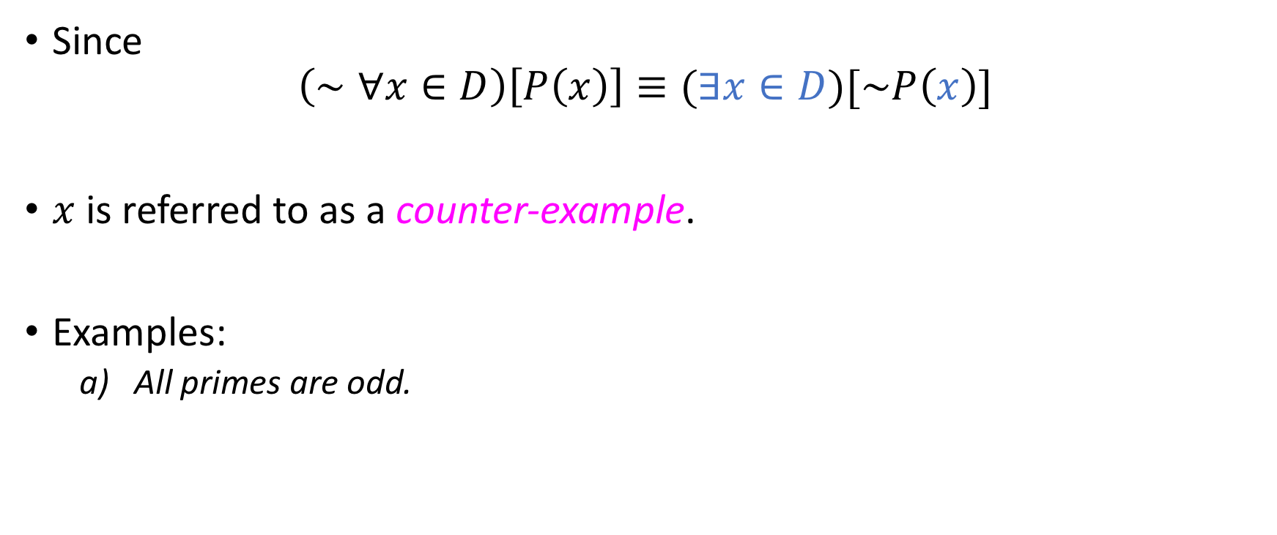
Arguing the negative: counter-example
Since
$$\left(∼∀x∈D\right)\left[P\left(x\right)\right]≡(∃x∈D)[\sim P\left(x\right)]$$
$x$ is referred to as a counter-example.
Examples:
All primes are odd.

Slide 15
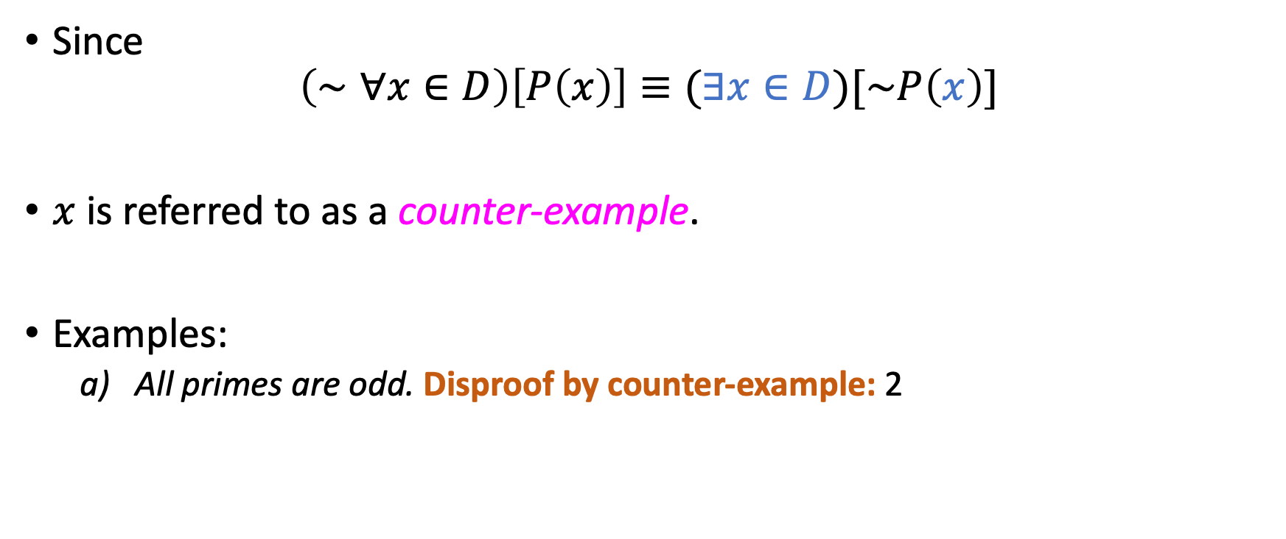
Arguing the negative: counter-example
Since
$$\left(∼∀x∈D\right)\left[P\left(x\right)\right]≡(∃x∈D)[\sim P\left(x\right)]$$
$x$ is referred to as a counter-example.
Examples:
All primes are odd. Disproof by counter-example: 2

Slide 16
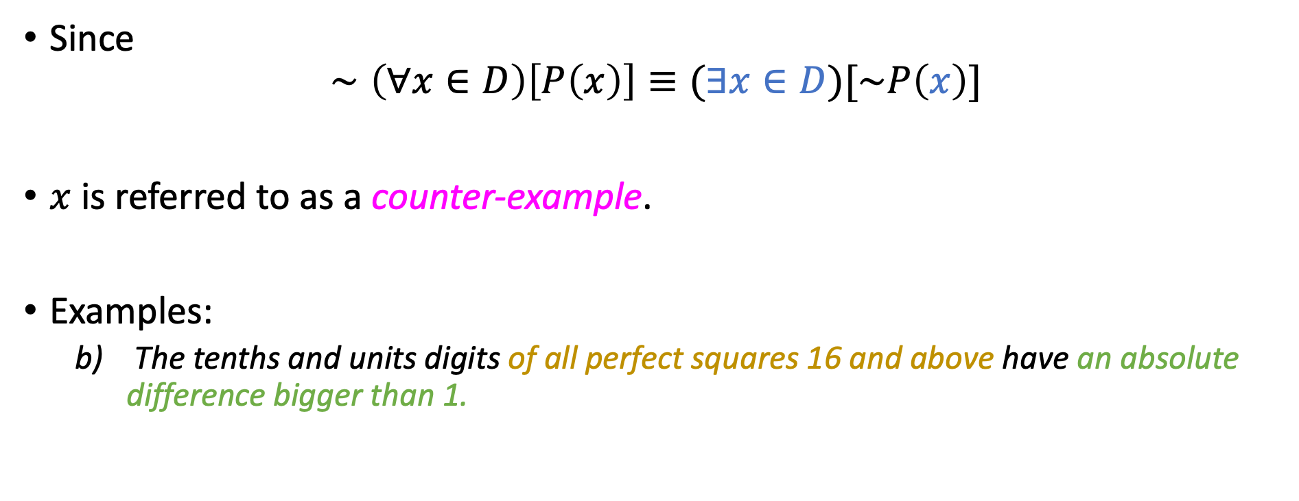
Arguing the negative: counter-example
Since
$$∼\left(∀x∈D\right)\left[P\left(x\right)\right]≡(∃x∈D)[\sim P\left(x\right)]$$
$x$ is referred to as a counter-example.
Examples:
The tenths and units digits of all perfect squares 16 and above have an absolute difference bigger than 1.

Slide 17
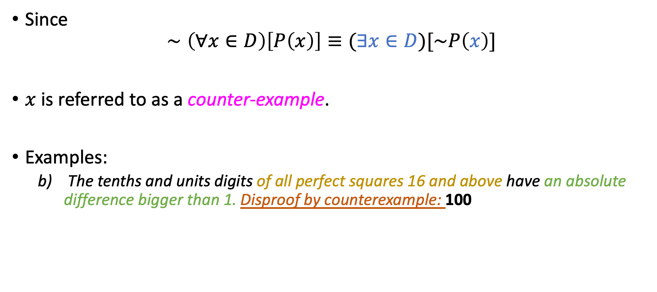
Arguing the negative: counter-example
Since
$$∼\left(∀x∈D\right)\left[P\left(x\right)\right]≡(∃x∈D)[\sim P\left(x\right)]$$
$x$ is referred to as a counter-example.
Examples:
The tenths and units digits of all perfect squares 16 and above have an absolute difference bigger than 1. Disproof by counterexample: 100

Slide 18
Arguing the affirmative of existential statements
Two methods:
Constructive
Non-Constructive
In “constructive” proofs we either explicitly show or construct an element of the domain that answers our query.
In non-constructive proofs (rare) we prove that it is a logical necessity for such an element to exist!
But we neither explicitly, nor implicitly, show or construct such an element!

Slide 19
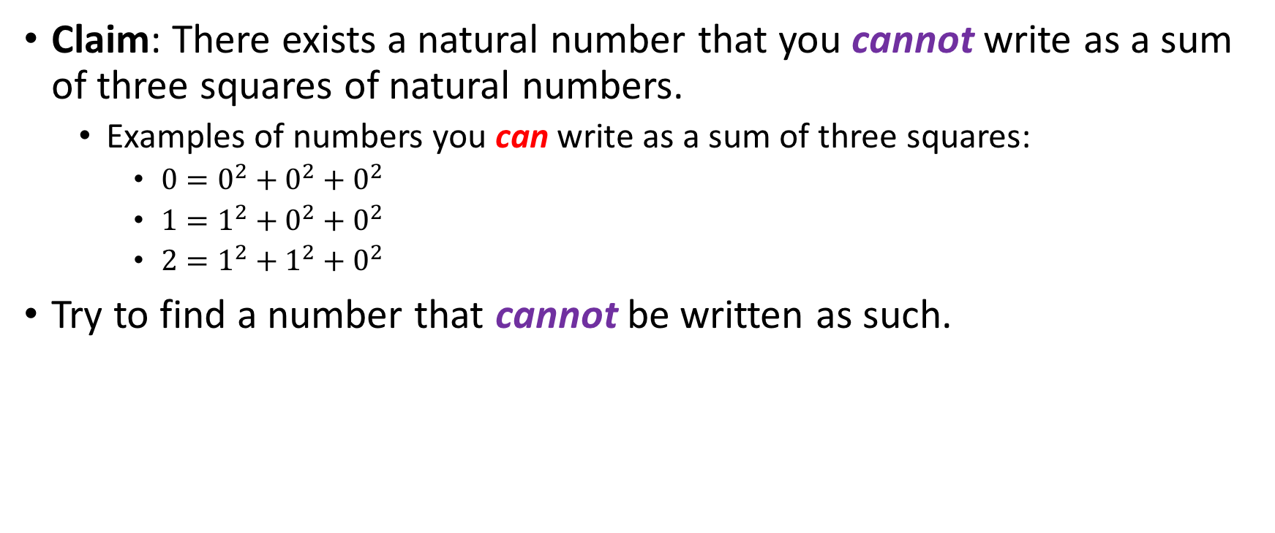
Our first constructive proof
Claim: There exists a natural number that you cannot write as a sum of three squares of natural numbers.
Examples of numbers you can write as a sum of three squares:
$0=0^{2}+0^{2}+0^{2}$
$1=1^{2}+0^{2}+0^{2}$
$2=1^{2}+1^{2}+0^{2}$
Try to find a number that cannot be written as such.

Slide 20
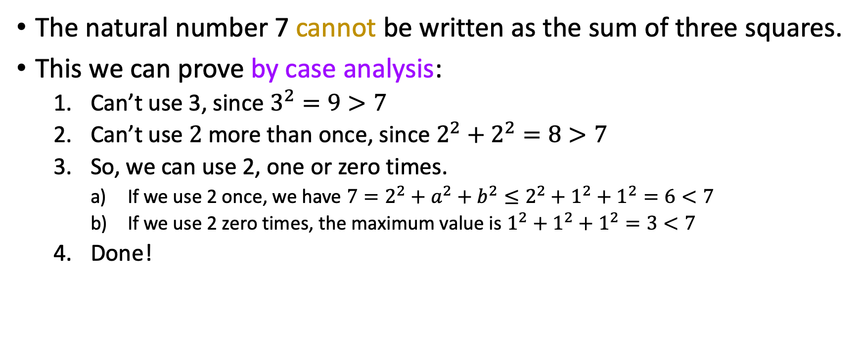
Proof
The natural number 7 cannot be written as the sum of three squares.
This we can prove by case analysis:
Can’t use 3, since $3^{2}=9>7$
Can’t use $2$ more than once, since $2^{2}+2^{2}=8>7$
So, we can use 2, one or zero times.
If we use 2 once, we have $7=2^{2}+a^{2}+b^{2}≤2^{2}+1^{2}+1^{2}=6<7$
If we use 2 zero times, the maximum value is $1^{2}+1^{2}+1^{2}=3<7$
Done!

Slide 21
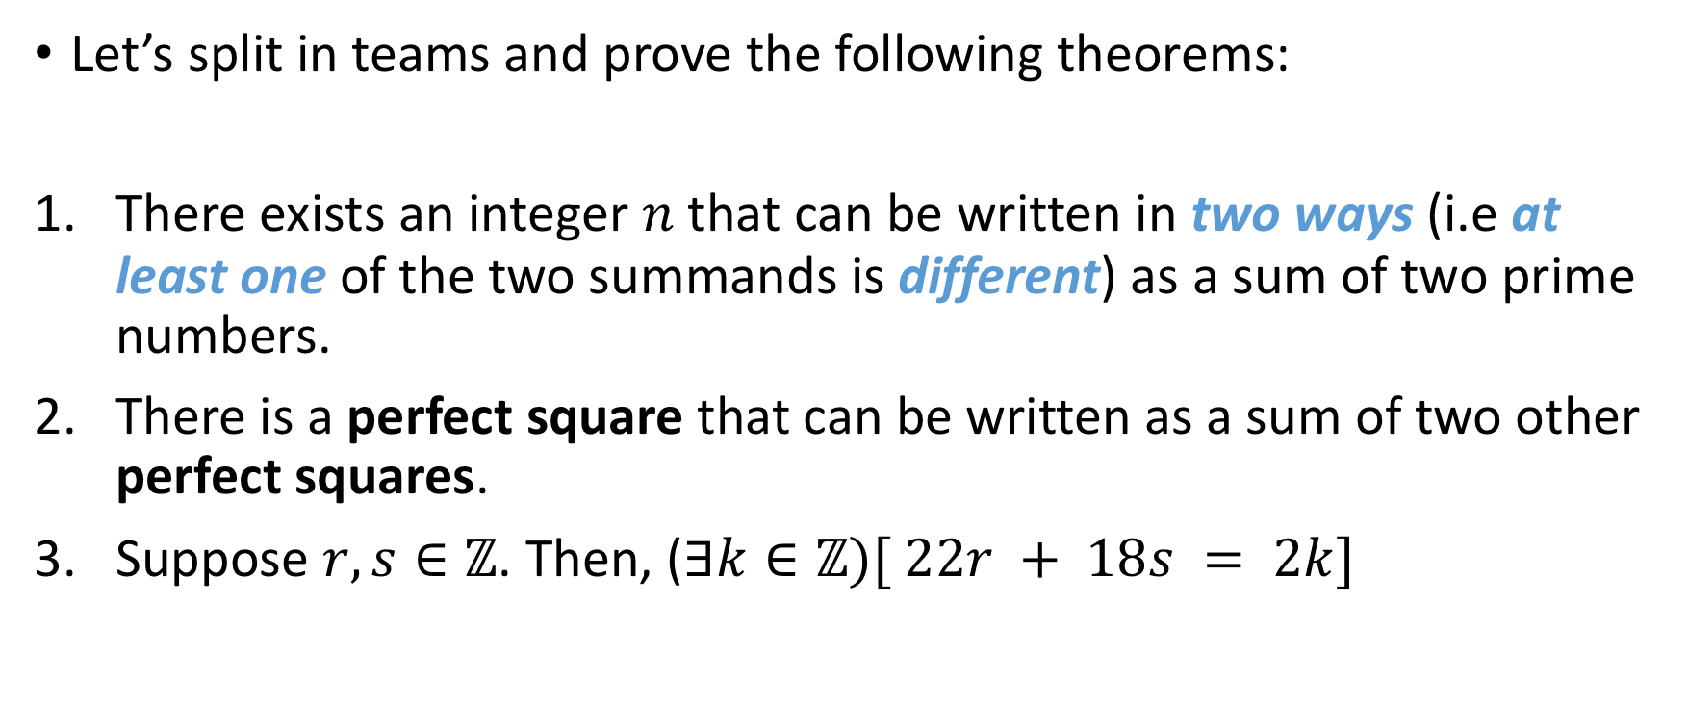
Your turn, class!
Let’s split in teams and prove the following theorems:
There exists an integer $n$ that can be written in two ways (i.e at least one of the two summands is different) as a sum of two prime numbers.
There is a perfect square that can be written as a sum of two other perfect squares.
Suppose $r, s∈ℤ$. Then, ($∃k∈ℤ)[ 22r + 18s = 2k]$
Notes:
1729: Ramanujan, Hardy,

Slide 22

Your turn, class!
Let’s split in teams and prove the following theorems:
There exists an integer $n$ that can be written in two ways (i.e at least one of the two summands is different) as a sum of two prime numbers.
There is a perfect square that can be written as a sum of two other perfect squares.
Suppose $r, s∈ℤ$. Then, ($∃k∈ℤ)[ 22r + 18s = 2k]$
How is the 3rd proof different from the others?
Notes:
(4) is the Ramanujan problem: the integer is 1729, known as the Hardy-Ramanujan number.

Slide 23
Existential statements for you!
Is there a perfect square 16 or greater whose units and tenths digits have an absolute difference of 4?

Slide 24

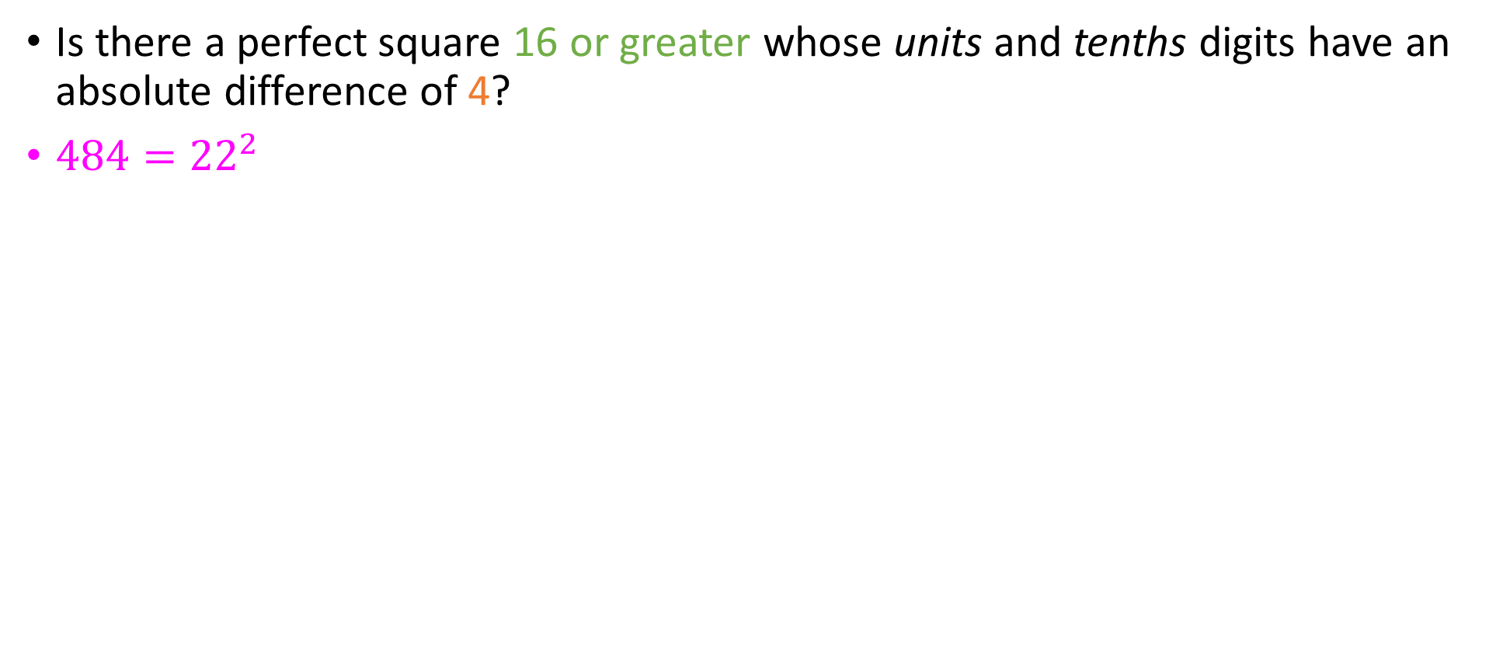
Existential statements for you!
Is there a perfect square 16 or greater whose units and tenths digits have an absolute difference of 4?
$484={22}^{2}$

Slide 25
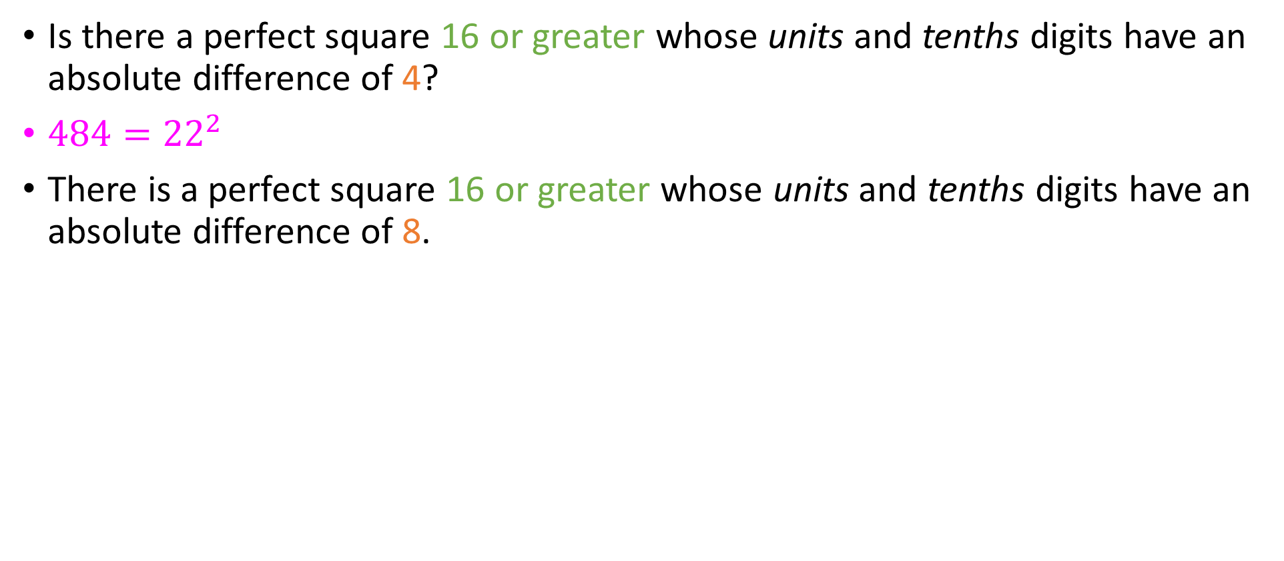
Existential statements for you!
Is there a perfect square 16 or greater whose units and tenths digits have an absolute difference of 4?
$484={22}^{2}$
There is a perfect square 16 or greater whose units and tenths digits have an absolute difference of 8.

Slide 26

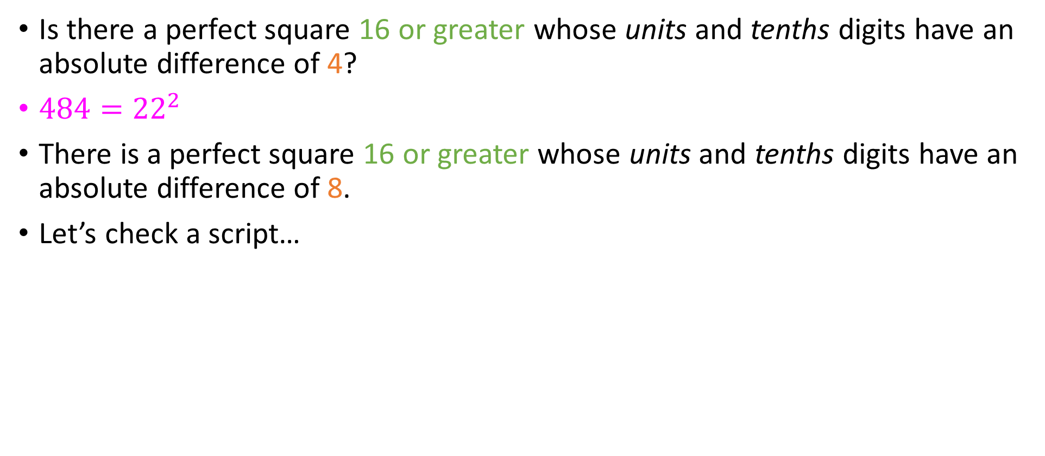
Existential statements for you!
Is there a perfect square 16 or greater whose units and tenths digits have an absolute difference of 4?
$484={22}^{2}$
There is a perfect square 16 or greater whose units and tenths digits have an absolute difference of 8.
Let’s check a script…

Slide 27
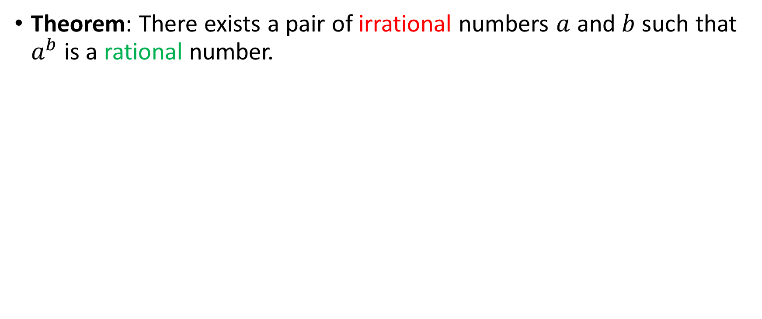
Our first non-constructive proof
Theorem: There exists a pair of irrational numbers $a$ and $b$ such that $a^{b}$is a rational number.
Notes:
Take it as a given (for now) that root of 2 is irrational.

Slide 28
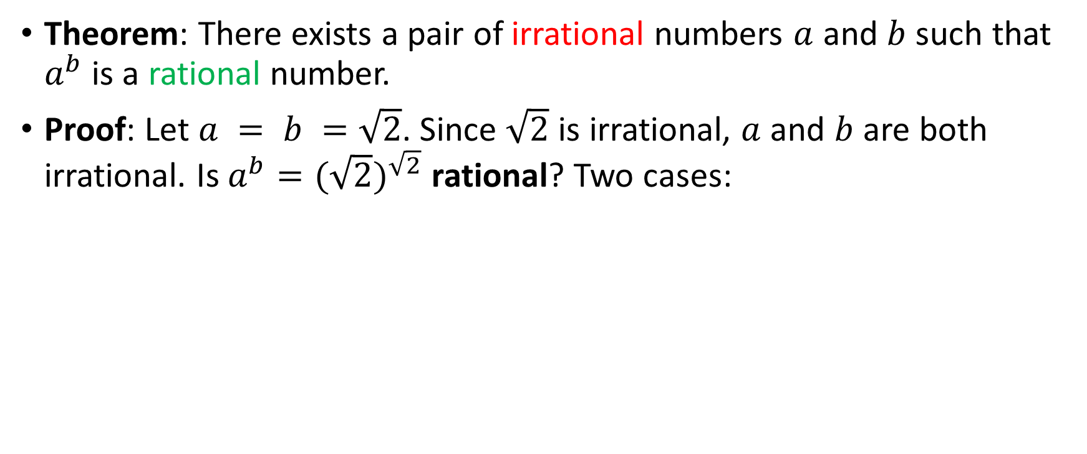
Our first non-constructive proof
Theorem: There exists a pair of irrational numbers $a$ and $b$ such that $a^{b}$is a rational number.
Proof: Let $a = b =\sqrt{2}$. Since $\sqrt{2}$ is irrational, $a$ and $b$ are both irrational. Is $a^{b}={(\sqrt{2})}^{\sqrt{2}}$ rational? Two cases:
Notes:
Take it as a given (for now) that root of 2 is irrational.

Slide 29
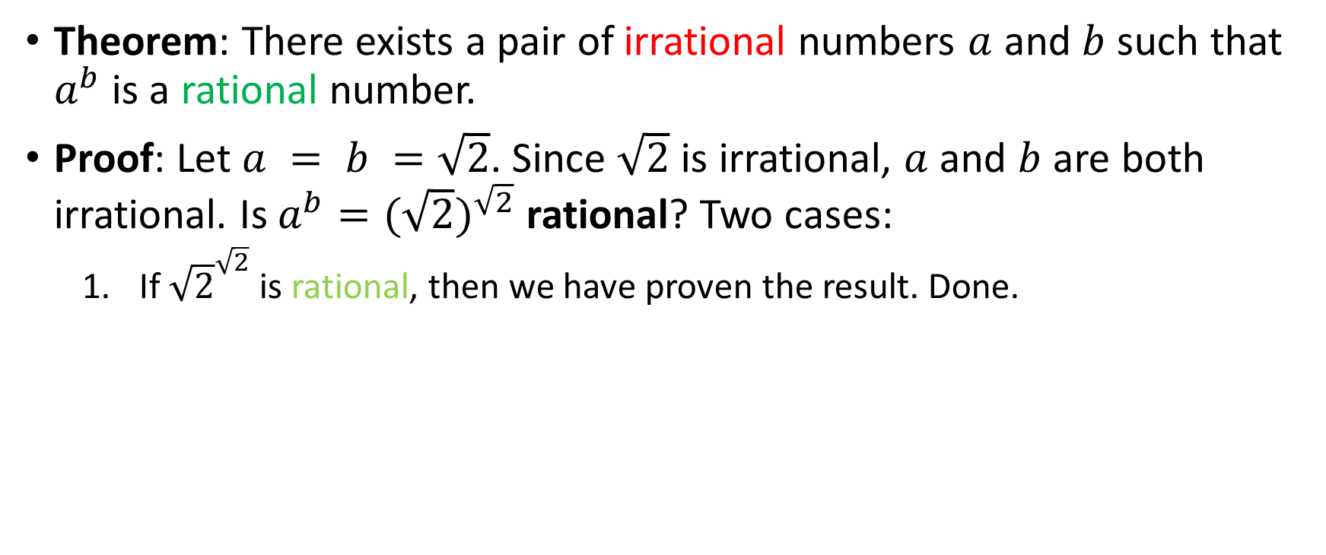
Our first non-constructive proof
Theorem: There exists a pair of irrational numbers $a$ and $b$ such that $a^{b}$is a rational number.
Proof: Let $a = b =\sqrt{2}$. Since $\sqrt{2}$ is irrational, $a$ and $b$ are both irrational. Is $a^{b}={(\sqrt{2})}^{\sqrt{2}}$ rational? Two cases:
If ${\sqrt{2}}^{\sqrt{2}}$ is rational, then we have proven the result. Done.
Notes:
Take it as a given (for now) that root of 2 is irrational.

Slide 30
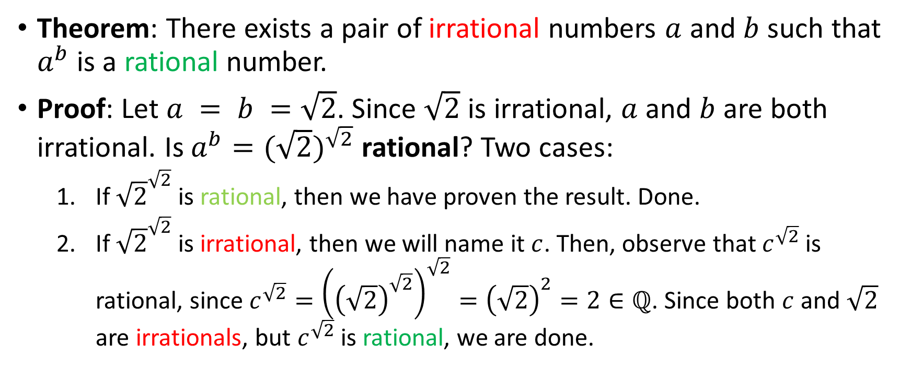
Our first non-constructive proof
Theorem: There exists a pair of irrational numbers $a$ and $b$ such that $a^{b}$is a rational number.
Proof: Let $a = b =\sqrt{2}$. Since $\sqrt{2}$ is irrational, $a$ and $b$ are both irrational. Is $a^{b}={(\sqrt{2})}^{\sqrt{2}}$ rational? Two cases:
If ${\sqrt{2}}^{\sqrt{2}}$ is rational, then we have proven the result. Done.
If ${\sqrt{2}}^{\sqrt{2}}$ is irrational, then we will name it $c$. Then, observe that $c^{\sqrt{2}}$ is rational, since $c^{\sqrt{2}}={\left({\left(\sqrt{2}\right)}^{\sqrt{2}}\right)}^{\sqrt{2}}={\left(\sqrt{2}\right)}^{2}=2∈ℚ$. Since both $c$ and $\sqrt{2}$ are irrationals, but $c^{\sqrt{2}}$ is rational, we are done.
Notes:
Take it as a given (for now) that root of 2 is irrational.

Slide 31
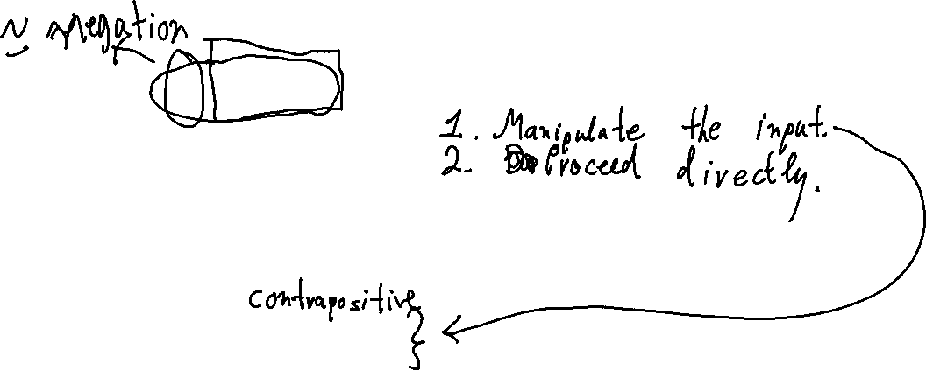
Indirect Proofs of Number Theory
Sometimes, proving a fact directly is tough.
In such cases, we can attempt an indirect proof
Those are split in two categories:
Proofs by contraposition
Proofs by contradiction
We will see examples of both.

Slide 32
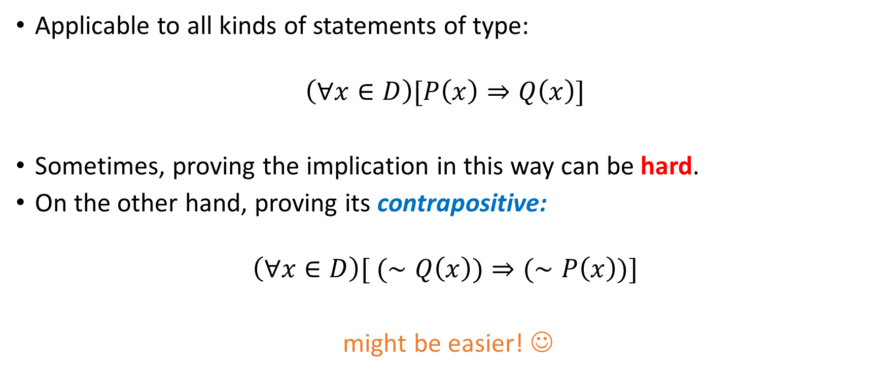
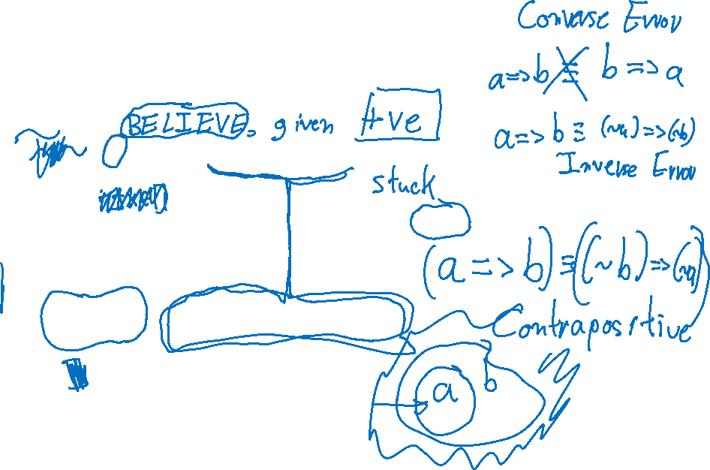
Proof by contraposition
Applicable to all kinds of statements of type:
$$\left(∀x∈D\right)[P\left(x\right)⇒Q\left(x\right)]$$
Sometimes, proving the implication in this way can be hard.
On the other hand, proving its contrapositive:
$$\left(∀x∈D\right)[ (∼Q\left(x\right))⇒(∼P\left(x\right))]$$
might be easier! ☺

Slide 33
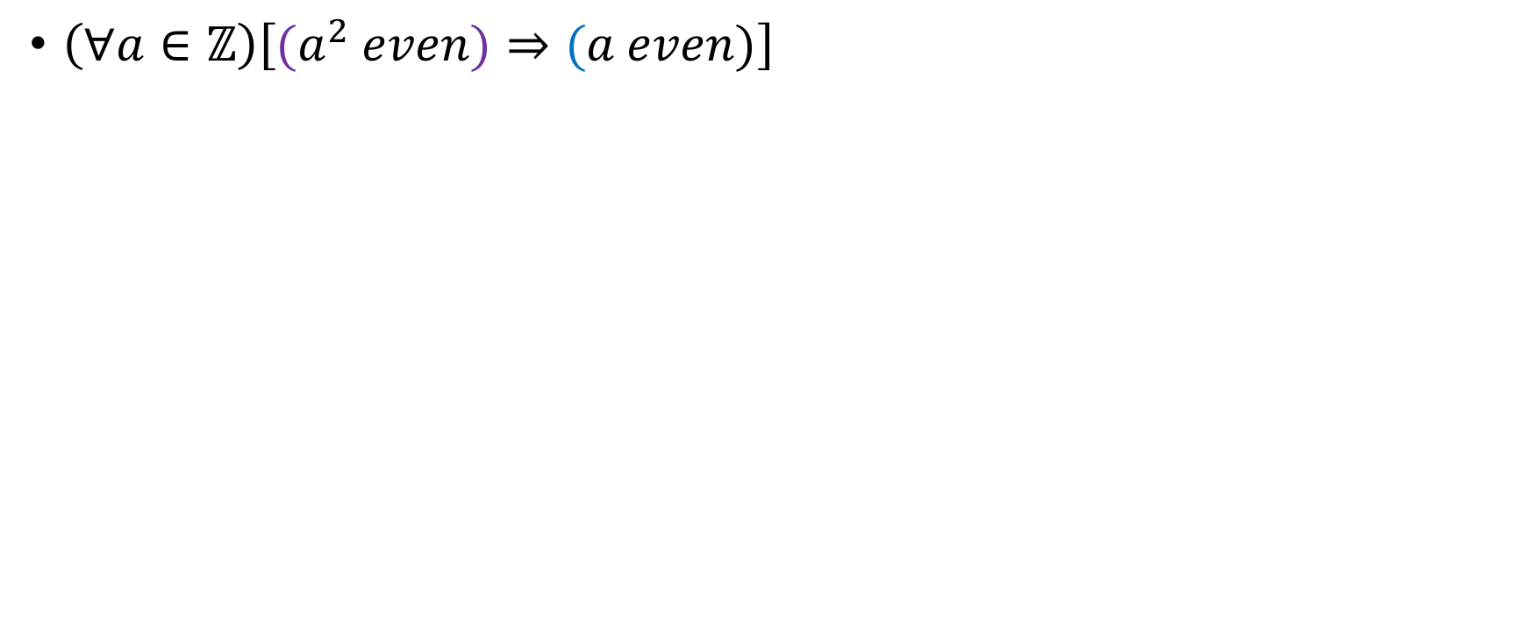
Examples
$\left(∀a∈ℤ\right)\left[{(a}^{2} even)⇒(a even)\right]$

Slide 34
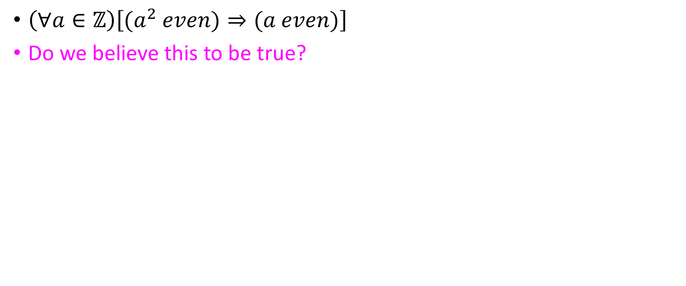
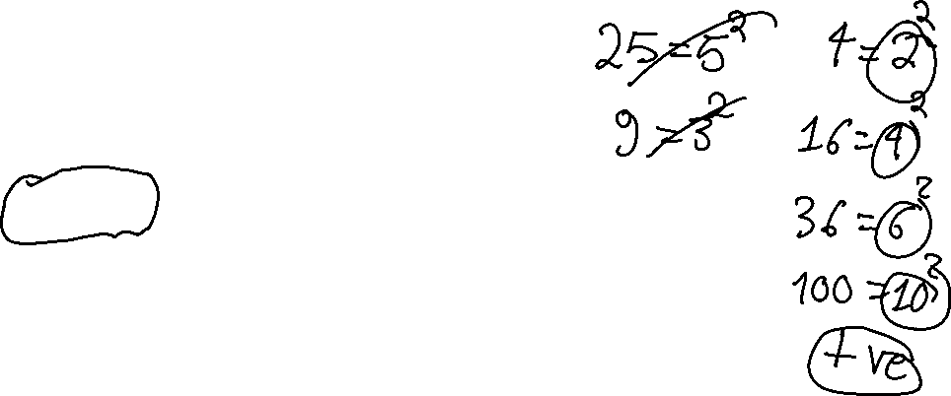
Examples
$\left(∀a∈ℤ\right)\left[{(a}^{2} even)⇒(a even)\right]$
Do we believe this to be true?
Yes
No

Slide 35
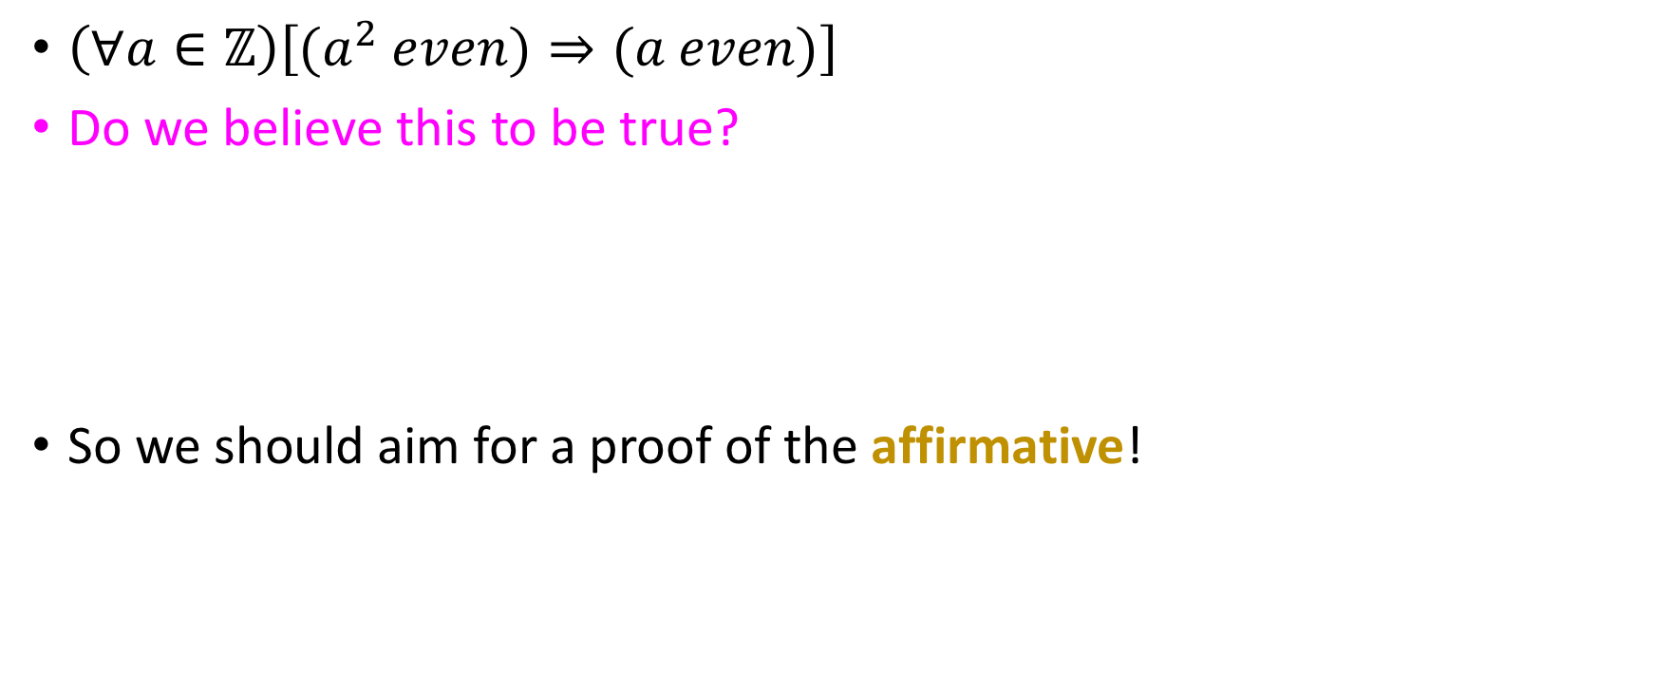
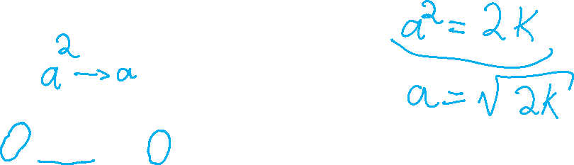
Examples
$\left(∀a∈ℤ\right)\left[{(a}^{2} even)⇒(a even)\right]$
Do we believe this to be true?
So we should aim for a proof of the affirmative!
Yes
No

Slide 36
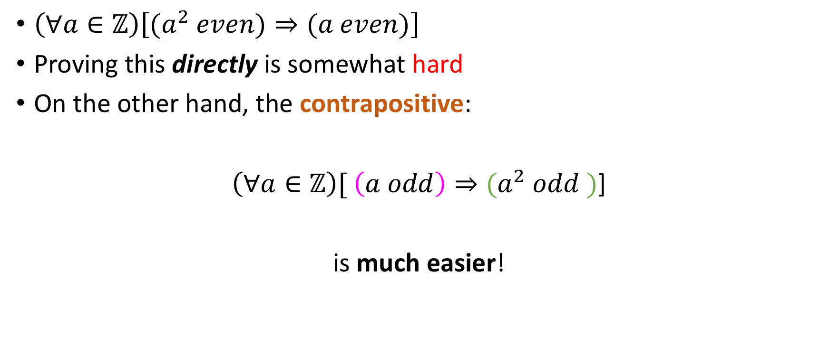
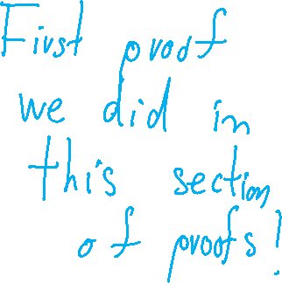
Examples
$\left(∀a∈ℤ\right)\left[{(a}^{2} even)⇒(a even)\right]$
Proving this directly is somewhat hard
On the other hand, the contrapositive:
$\left(∀a∈ℤ\right)[ \left(a odd\right)⇒{(a}^{2} odd )$]
is much easier!

Slide 37
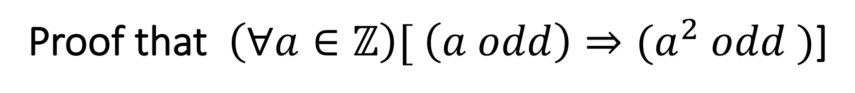

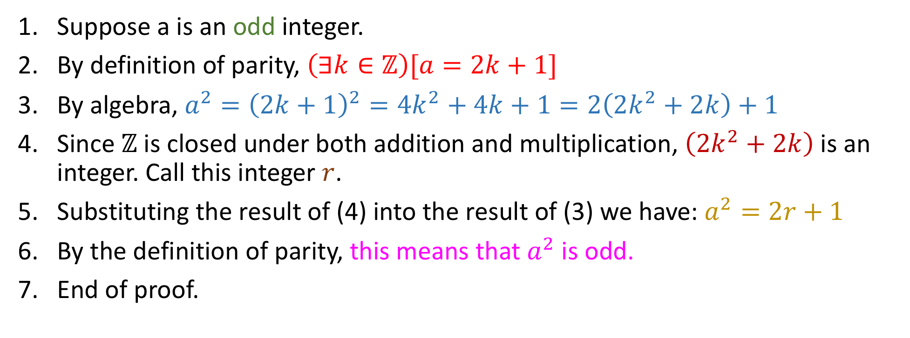
Proof that $\left(∀a∈ℤ\right)[ \left(a odd\right)⇒{(a}^{2} odd )$]
(Listified style, you can choose a different one if you want)
Suppose a is an odd integer.
By definition of parity, $\left(∃k∈ℤ\right)[a=2k+1]$
By algebra, $a^{2}={\left(2k+1\right)}^{2}=4k^{2}+4k+1=2\left(2k^{2}+2k\right)+1$
Since $ℤ$ is closed under both addition and multiplication, $\left(2k^{2}+2k\right)$ is an integer. Call this integer $r$.
Substituting the result of (4) into the result of (3) we have: $a^{2}=2r+1$
By the definition of parity, this means that $a^{2}$ is odd.
End of proof.
Notes:
Do it via parity first on paper, and then present the half line mod solution

Slide 38
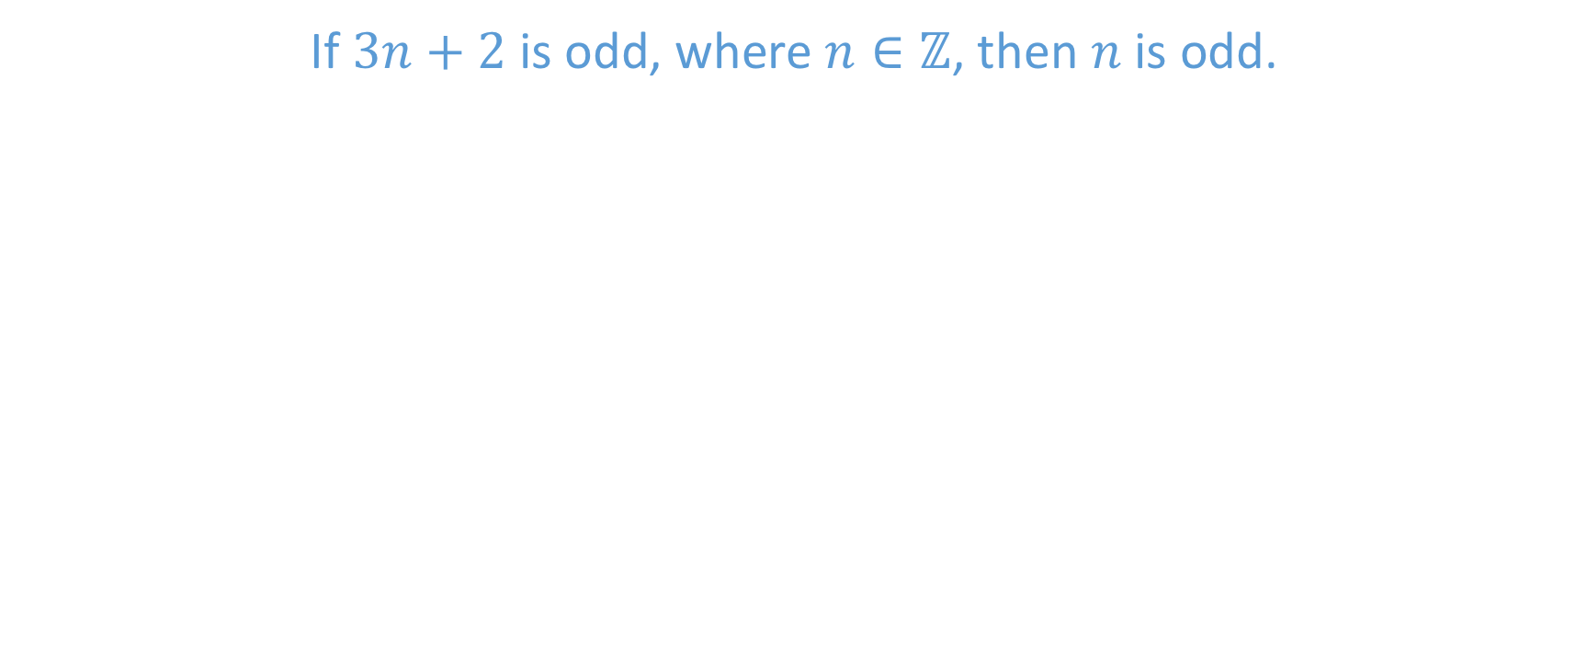
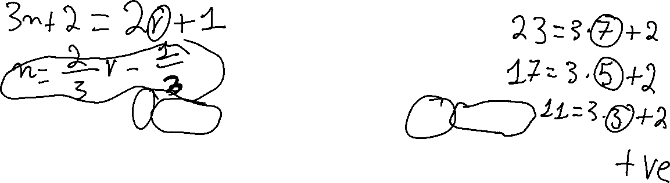
Another example
If $3n+2$ is odd, where $n∈ℤ$, then $n$ is odd.

Slide 39
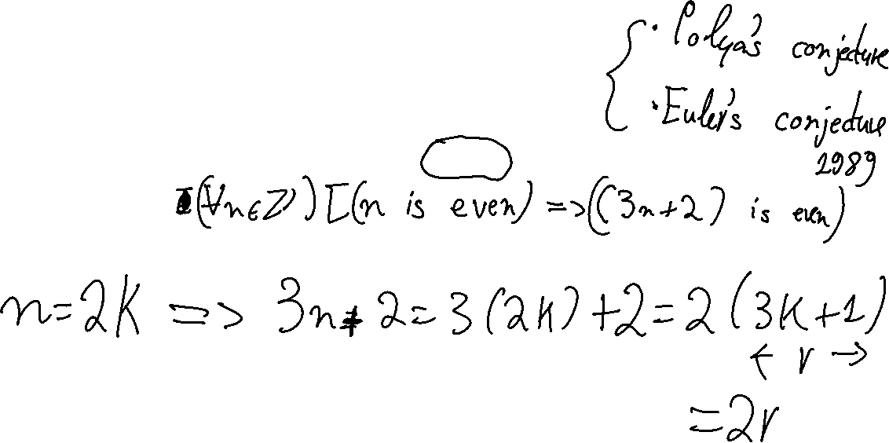
Another example
If $3n+2$ is odd, where $n∈ℤ$, then $n$ is odd.
Let’s try this one together.

Slide 40
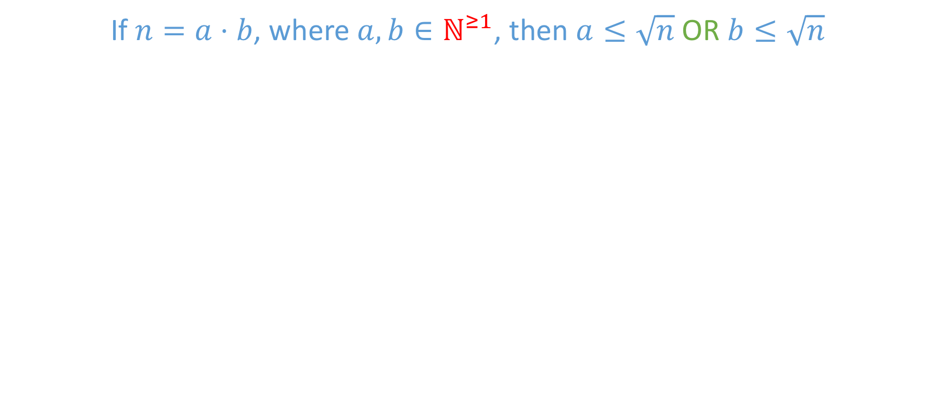
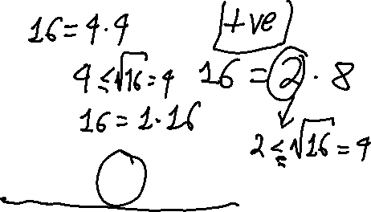
Another example
If $n=a⋅b$, where $a,b∈ℕ^{≥1}$, then $a≤\sqrt{n}$ OR $b≤\sqrt{n}$

Slide 41

Another example
If $n=a⋅b$, where $a,b∈ℕ^{≥1}$, then $a≤\sqrt{n}$ OR $b≤\sqrt{n}$

Slide 42
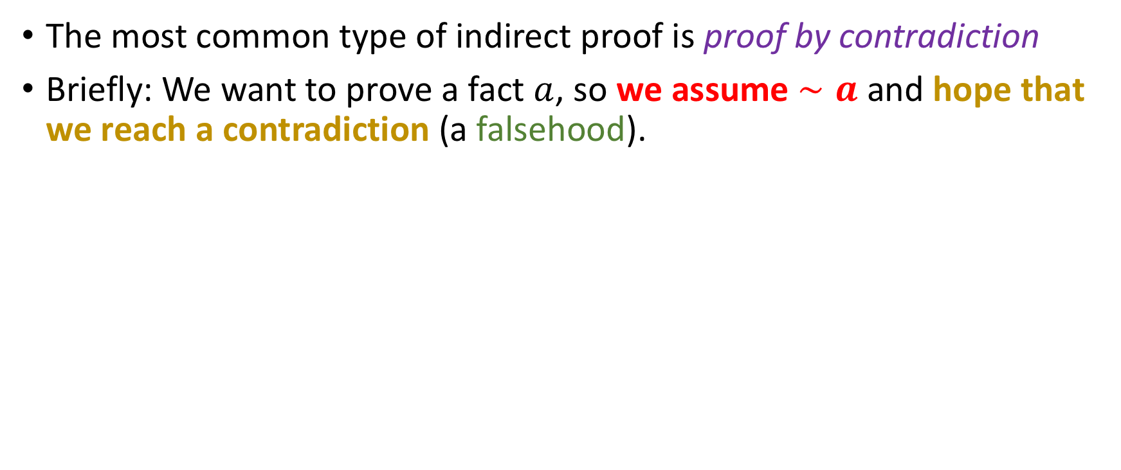
Proof by contradiction
The most common type of indirect proof is proof by contradiction
Briefly: We want to prove a fact $a$, so we assume $∼a$ and hope that we reach a contradiction (a falsehood).

Slide 43

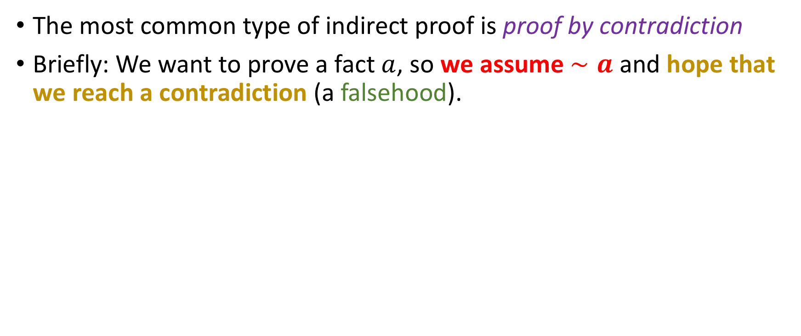
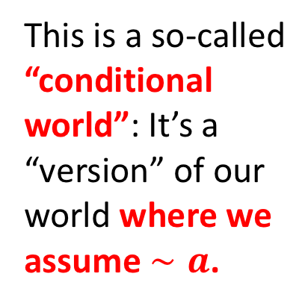
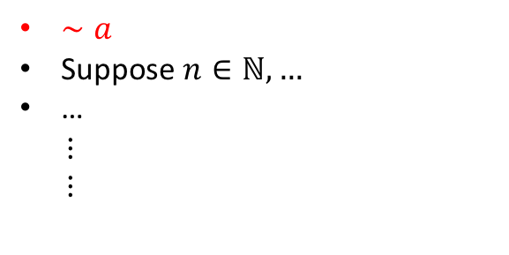
Proof by contradiction
The most common type of indirect proof is proof by contradiction
Briefly: We want to prove a fact $a$, so we assume $∼a$ and hope that we reach a contradiction (a falsehood).
$∼a$
Suppose $n∈ℕ,…$
…
$⋮$
$⋮$
This is a so-called “conditional world”: It’s a “version” of our world where we assume $∼a$.

Slide 44

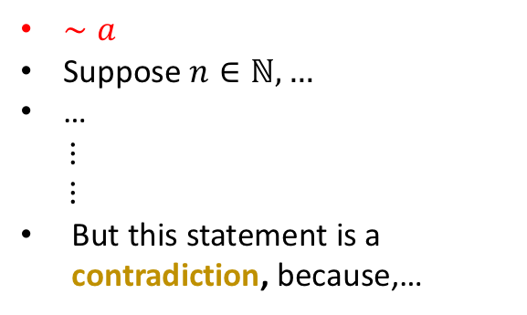
Proof by contradiction
The most common type of indirect proof is proof by contradiction
Briefly: We want to prove a fact $a$, so we assume $∼a$ and hope that we reach a contradiction (a falsehood).
$∼a$
Suppose $n∈ℕ,…$
…
$⋮$
$⋮$
But this statement is a contradiction, because,…
We follow some classic direct proof sets, and reach a statement that is a logical contradiction! (e.g 1 > 2)

Slide 45
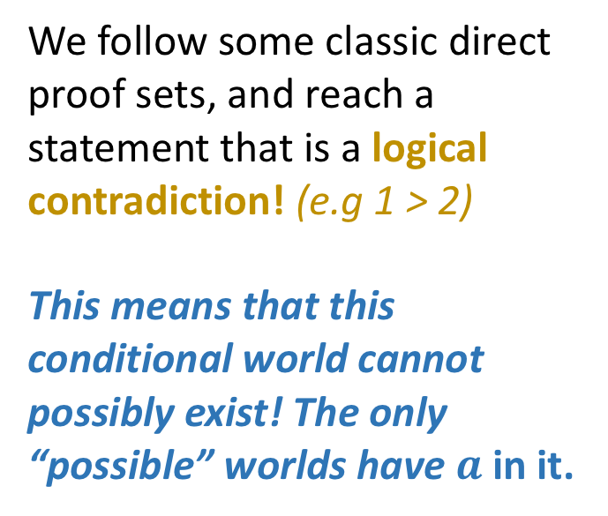
Proof by contradiction
The most common type of indirect proof is proof by contradiction
Briefly: We want to prove a fact $a$, so we assume $∼a$ and hope that we reach a contradiction (a falsehood).
We follow some classic direct proof sets, and reach a statement that is a logical contradiction! (e.g 1 > 2)
This means that this conditional world cannot possibly exist! The only “possible” worlds have $a$ in it.
$∼a$
Suppose $n∈ℕ,…$
…
$⋮$
$⋮$
But this statement is a contradiction, because,…

Slide 46

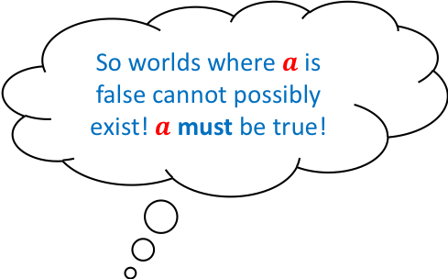
Proof by contradiction
The most common type of indirect proof is proof by contradiction
Briefly: We want to prove a fact $a$, so we assume $∼a$ and hope that we reach a contradiction (a falsehood).
So worlds where $a$is false cannot possibly exist! $a$must be true!
We follow some classic direct proof sets, and reach a statement that is a logical contradiction! (e.g 1 > 2)
This means that this conditional world cannot possibly exist! The only “possible” worlds have $a$ in it.
$∼a$
Suppose $n∈ℕ,…$
…
$⋮$
$⋮$
But this statement is a contradiction, because,…

Slide 47
Proof by contradiction
Proof of contradiction is often used in statements that look obvious!
Example: We will prove that there is no greatest integer.

Slide 48
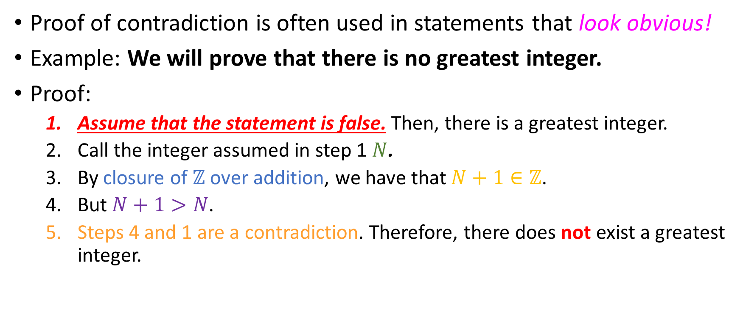
Proof by contradiction
Proof of contradiction is often used in statements that look obvious!
Example: We will prove that there is no greatest integer.
Proof:
Assume that the statement is false. Then, there is a greatest integer.
Call the integer assumed in step 1 $N$.
By closure of $ℤ$ over addition, we have that $N+1∈ℤ$.
But $N+1>N$.
Steps 4 and 1 are a contradiction. Therefore, there does not exist a greatest integer.

Slide 49
Another
Statement: There is no least positive rational.

Slide 50
Another
Statement: There is no least positive rational.
Proof (by contradiction):

Slide 51
Another
Statement: There is no least positive rational.
Proof (by contradiction):
Assume not. Then, there exists a least positive rational.

Slide 52
Another
Statement: There is no least positive rational.
Proof (by contradiction):
Assume not. Then, there exists a least positive rational.
Let this rational be called q.

Slide 53
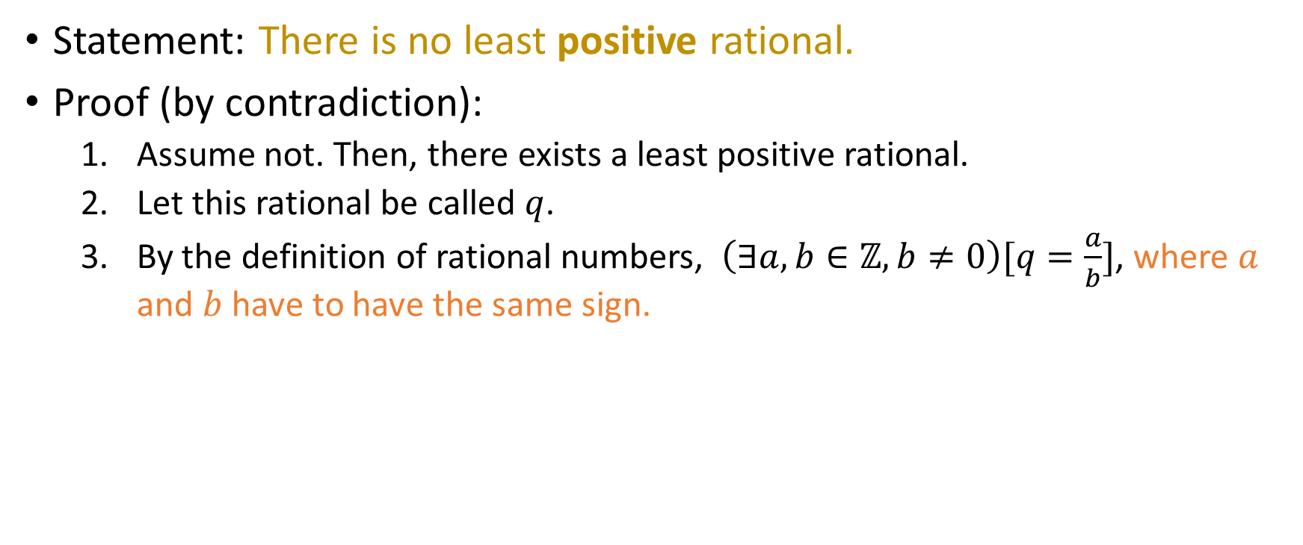
Another
Statement: There is no least positive rational.
Proof (by contradiction):
Assume not. Then, there exists a least positive rational.
Let this rational be called $q$.
By the definition of rational numbers, $\left(∃a,b∈ℤ, b≠0\right)[q=\frac{a}{b}]$, where $a$ and $b$ have to have the same sign.

Slide 54

Another
Statement: There is no least positive rational.
Proof (by contradiction):
Assume not. Then, there exists a least positive rational.
Let this rational be called $q$.
By the definition of rational numbers, $\left(∃a,b∈ℤ, b≠0\right)[q=\frac{a}{b}]$, where $a$ and $b$ have to have the same sign.
Regardless of the sign of $a$ and $b$, $q^{′}=\frac{a}{2⋅b}$ is a positive rational, and it also smaller than $q$.

Slide 55

Another
Statement: There is no least positive rational.
Proof (by contradiction):
Assume not. Then, there exists a least positive rational.
Let this rational be called $q$.
By the definition of rational numbers, $\left(∃a,b∈ℤ, b≠0\right)[q=\frac{a}{b}]$, where $a$ and $b$ have to have the same sign.
Regardless of the sign of $a$ and $b$, $q^{′}=\frac{a}{2⋅b}$ is a positive rational, and it also smaller than $q$.
Contradiction, since we assumed that $q$ was the least positive rational.

Slide 56

Another
Statement: There is no least positive rational.
Proof (by contradiction):
Assume not. Then, there exists a least positive rational.
Let this rational be called $q$.
By the definition of rational numbers, $\left(∃a,b∈ℤ, b≠0\right)[q=\frac{a}{b}]$, where $a$ and $b$ have to have the same sign.
Regardless of the sign of $a$ and $b$, $q^{′}=\frac{a}{2⋅b}$ is a positive rational, and it also smaller than $q$.
Contradiction, since we assumed that $q$ was the least positive rational.
Therefore, there does not exist one such least positive rational.

Slide 57
Your turn!
Prove that the square root of any irrational is also irrational

Slide 58
Reminders / Your Concerns
Lifted late homework deadline for homework 7.
So submit through tonight for full credit!
We are aware of 9.4 vs 10 points EC for homework 5, it’s an easy fix.
Apologies for Gradescope not allowing partial credit for multiple questions.
When we end mods (today / Thursday) we are done with M2 material.

Slide 59


A historical proof by contradiction: $\sqrt{2}$ is irrational

Slide 60

A historical proof by contradiction: $\sqrt{2}$ is irrational
Let’s assume BY WAY OF CONTRADICTION that $\sqrt{2}$ is rational.

Slide 61

A historical proof by contradiction: $\sqrt{2}$ is irrational
Let’s assume BY WAY OF CONTRADICTION that $\sqrt{2}$ is rational.
So $\sqrt{2}=\frac{a}{b}, a,b∈ℤ, b≠0$ and $a,b$ do not have common factors.

Slide 62

A historical proof by contradiction: $\sqrt{2}$ is irrational
Let’s assume BY WAY OF CONTRADICTION that $\sqrt{2}$ is rational.
So $\sqrt{2}=\frac{a}{b}, a,b∈ℤ, b≠0$ and $a,b$ do not have common factors.
So $a=\sqrt{2}⋅b⇒a^{2}=2b^{2}$ so $a^{2}$ is even (1)

Slide 63

A historical proof by contradiction: $\sqrt{2}$ is irrational
Let’s assume BY WAY OF CONTRADICTION that $\sqrt{2}$ is rational.
So $\sqrt{2}=\frac{a}{b}, a,b∈ℤ, b≠0$ and $a,b$ do not have common factors.
So $a=\sqrt{2}⋅b⇒a^{2}=2b^{2}$ so $a^{2}$ is even (1)
By the theorem proved before, this means that $a$ is even.

Slide 64

A historical proof by contradiction: $\sqrt{2}$ is irrational
Let’s assume BY WAY OF CONTRADICTION that $\sqrt{2}$ is rational.
So $\sqrt{2}=\frac{a}{b}, a,b∈ℤ, b≠0$ and $a,b$ do not have common factors.
So $a=\sqrt{2}⋅b⇒a^{2}=2b^{2}$ so $a^{2}$ is even (1)
By the theorem proved before, this means that $a$ is even.
So $a=2k$ for some integer $k$. (2)

Slide 65

A historical proof by contradiction: $\sqrt{2}$ is irrational
Let’s assume BY WAY OF CONTRADICTION that $\sqrt{2}$ is rational.
So $\sqrt{2}=\frac{a}{b}, a,b∈ℤ, b≠0$ and $a,b$ do not have common factors.
So $a=\sqrt{2}⋅b⇒a^{2}=2b^{2}$ so $a^{2}$ is even (1)
By the theorem proved before, this means that $a$ is even.
So $a=2k$ for some integer $k$. (2)
Substituting (2) into (1) yields: ${\left(2k\right)}^{2}=2b^{2}⇒b^{2}=2k^{2}⇒$

Slide 66

A historical proof by contradiction: $\sqrt{2}$ is irrational
Let’s assume BY WAY OF CONTRADICTION that $\sqrt{2}$ is rational.
So $\sqrt{2}=\frac{a}{b}, a,b∈ℤ, b≠0$ and $a,b$ do not have common factors.
So $a=\sqrt{2}⋅b⇒a^{2}=2b^{2}$ so $a^{2}$ is even (1)
By the theorem proved before, this means that $a$ is even.
So $a=2k$ for some integer $k$. (2)
Substituting (2) into (1) yields: ${\left(2k\right)}^{2}=2b^{2}⇒b^{2}=2k^{2}⇒$
$b^{2}$ is even $⇒$ $b$ is even by previous theorem!

Slide 67

A historical proof by contradiction: $\sqrt{2}$ is irrational
Let’s assume BY WAY OF CONTRADICTION that $\sqrt{2}$ is rational.
So $\sqrt{2}=\frac{a}{b}, a,b∈ℤ, b≠0$ and $a,b$ do not have common factors.
So $a=\sqrt{2}⋅b⇒a^{2}=2b^{2}$ so $a^{2}$ is even (1)
By the theorem proved before, this means that $a$ is even.
So $a=2k$ for some integer $k$. (2)
Substituting (2) into (1) yields: ${\left(2k\right)}^{2}=2b^{2}⇒b^{2}=2k^{2}⇒$
$b^{2}$ is even $⇒$ $b$ is even by previous theorem!
So both $a$ and $b$ are both even, which means that they have common factor of 2.

Slide 68

A historical proof by contradiction: $\sqrt{2}$ is irrational
Let’s assume BY WAY OF CONTRADICTION that $\sqrt{2}$ is rational.
So $\sqrt{2}=\frac{a}{b}, a,b∈ℤ, b≠0$ and $a,b$ do not have common factors.
So $a=\sqrt{2}⋅b⇒a^{2}=2b^{2}$ so $a^{2}$ is even (1)
By the theorem proved before, this means that $a$ is even.
So $a=2k$ for some integer $k$. (2)
Substituting (2) into (1) yields: ${\left(2k\right)}^{2}=2b^{2}⇒b^{2}=2k^{2}⇒$
$b^{2}$ is even $⇒$ $b$ is even by previous theorem!
So both $a$ and $b$ are both even, which means that they have common factor of 2.
Contradiction.

Slide 69

Proof of a lemma
Proof (via contraposition): We prove the contrapositive, i.e
If $a^{2}$is a multiple of 5, then so is $a$ $$⇔$$
If $a$is not a multiple of 5, then $a^{2}$ isn’t one either.

Slide 70

Proof of lemma
Proof (by contraposition): We prove that:
if $a$is not a multiple of 5, then $a^{2}$ isn’t one either.

Slide 71

Proof of lemma
Proof (by contraposition): We prove that:
if $a$is not a multiple of 5, then $a^{2}$ isn’t one either.
Suppose that $a∈ℤ$ is not a multiple of 5.

Slide 72

Proof of lemma
Proof (by contraposition): We prove that:
if $a$is not a multiple of 5, then $a^{2}$ isn’t one either.
Suppose that $a∈ℤ$ is not a multiple of 5.
Then, there exists a unique integer $q$ such that $a$ can be written in one of 4 ways:

Slide 73


Proof of lemma
Proof (by contraposition): We prove that:
if $a$is not a multiple of 5, then $a^{2}$ isn’t one either.
Suppose that $a∈ℤ$ is not a multiple of 5.
Then, there exists a unique integer $q$ such that $a$ can be written in one of 4 ways:
$\left(a=5q+1\right)⇒a^{2}=25q^{2}+10q+1=5\underbrace{\left(5q^{2}+2q\right)}+1=5m+1⇒a^{2}$ not multiple of 5
$$m∈ℤ$$

Slide 74

Proof of lemma
Proof (by contraposition): We prove that:
if $a$is not a multiple of 5, then $a^{2}$ isn’t one either.
Suppose that $a∈ℤ$ is not a multiple of 5.
Then, there exists a unique integer $q$ such that $a$ can be written in one of 4 ways:
$\left(a=5q+1\right)⇒a^{2}=25q^{2}+10q+1=5\underbrace{\left(5q^{2}+2q\right)}+1=5m+1⇒a^{2}$ not multiple of 5
$\left(a=5q+2\right)⇒a^{2}=25q^{2}+20q+4=5(5q^{2}+4q)+4=5m+4⇒a^{2}$ not multiple of 5
$$m∈ℤ$$

Slide 75

Proof of lemma
Proof (by contraposition): We prove that:
if $a$is not a multiple of 5, then $a^{2}$ isn’t one either.
Suppose that $a∈ℤ$ is not a multiple of 5.
Then, there exists a unique integer $q$ such that $a$ can be written in one of 4 ways:
$\left(a=5q+1\right)⇒a^{2}=25q^{2}+10q+1=5\underbrace{\left(5q^{2}+2q\right)}+1=5m+1⇒a^{2}$ not multiple of 5
$\left(a=5q+2\right)⇒a^{2}=25q^{2}+20q+4=5(5q^{2}+4q)+4=5m+4⇒a^{2}$ not multiple of 5
$\left(a=5q+3\right)⇒a^{2}=25q^{2}+30q+\underbrace{9}=5(5q^{2}+6q+1)+4=5m+4⇒a^{2}$ not multiple of 5
$$m∈ℤ$$
$$5+4$$

Slide 76

Proof of lemma
Proof (by contraposition): We prove that:
if $a$is not a multiple of 5, then $a^{2}$ isn’t one either.
Suppose that $a∈ℤ$ is not a multiple of 5.
Then, there exists a unique integer $q$ such that $a$ can be written in one of 4 ways:
$\left(a=5q+1\right)⇒a^{2}=25q^{2}+10q+1=5\underbrace{\left(5q^{2}+2q\right)}+1=5m+1⇒a^{2}$ not multiple of 5
$\left(a=5q+2\right)⇒a^{2}=25q^{2}+20q+4=5(5q^{2}+4q)+4=5m+4⇒a^{2}$ not multiple of 5
$\left(a=5q+3\right)⇒a^{2}=25q^{2}+30q+\underbrace{9}=5(5q^{2}+6q+1)+4=5m+4⇒a^{2}$ not multiple of 5
$\left(a=5q+4\right)⇒a^{2}=25q^{2}+40q+\underbrace{16}=5(5q^{2}+8q+3)+1=5m+1⇒a^{2}$ not multiple of 5
$$m∈ℤ$$
$$5+4$$
$$3∗5+1$$

Slide 77

Proof of lemma
Proof (by contraposition): We prove that:
if $a$is not a multiple of 5, then $a^{2}$ isn’t one either.
Suppose that $a∈ℤ$ is not a multiple of 5.
Then, there exists a unique integer $q$ such that $a$ can be written in one of 4 ways:
$\left(a=5q+1\right)⇒a^{2}=25q^{2}+10q+1=5\underbrace{\left(5q^{2}+2q\right)}+1=5m+1⇒a^{2}$ not multiple of 5
$\left(a=5q+2\right)⇒a^{2}=25q^{2}+20q+4=5(5q^{2}+4q)+4=5m+4⇒a^{2}$ not multiple of 5
$\left(a=5q+3\right)⇒a^{2}=25q^{2}+30q+\underbrace{9}=5(5q^{2}+6q+1)+4=5m+4⇒a^{2}$ not multiple of 5
$\left(a=5q+4\right)⇒a^{2}=25q^{2}+40q+\underbrace{16}=5(5q^{2}+8q+3)+1=5m+1⇒a^{2}$ not multiple of 5
So, in all possible cases, we found that $a^{2}$ is not a multiple of 5.
$$m∈ℤ$$
$$5+4$$
$$3∗5+1$$

Slide 78

Proof of lemma
Proof (by contraposition): We prove that:
if $a$is not a multiple of 5, then $a^{2}$ isn’t one either.
Suppose that $a∈ℤ$ is not a multiple of 5.
Then, there exists a unique integer $q$ such that $a$ can be written in one of 4 ways:
$\left(a=5q+1\right)⇒a^{2}=25q^{2}+10q+1=5\underbrace{\left(5q^{2}+2q\right)}+1=5m+1⇒a^{2}$ not multiple of 5
$\left(a=5q+2\right)⇒a^{2}=25q^{2}+20q+4=5(5q^{2}+4q)+4=5m+4⇒a^{2}$ not multiple of 5
$\left(a=5q+3\right)⇒a^{2}=25q^{2}+30q+\underbrace{9}=5(5q^{2}+6q+1)+4=5m+4⇒a^{2}$ not multiple of 5
$\left(a=5q+4\right)⇒a^{2}=25q^{2}+40q+\underbrace{16}=5(5q^{2}+8q+3)+1=5m+1⇒a^{2}$ not multiple of 5
So, in all possible cases, we found that $a^{2}$ is not a multiple of 5.
Done.
$$m∈ℤ$$
$$5+4$$
$$3∗5+1$$

Slide 79




Proof of lemma
Proof (by contraposition): We prove that:
if $a$is not a multiple of 5, then $a^{2}$ isn’t one either.
Suppose that $a∈ℤ$ is not a multiple of 5.
Then, there exists a unique integer $q$ such that $a$ can be written in one of 4 ways:
$\left(a=5q+1\right)⇒a^{2}=25q^{2}+10q+1=5\underbrace{\left(5q^{2}+2q\right)}+1=5m+1⇒a^{2}$ not multiple of 5
$\left(a=5q+2\right)⇒a^{2}=25q^{2}+20q+4=5(5q^{2}+4q)+4=5m+4⇒a^{2}$ not multiple of 5
$\left(a=5q+3\right)⇒a^{2}=25q^{2}+30q+\underbrace{9}=5(5q^{2}+6q+1)+4=5m+4⇒a^{2}$ not multiple of 5
$\left(a=5q+4\right)⇒a^{2}=25q^{2}+40q+\underbrace{16}=5(5q^{2}+8q+3)+1=5m+1⇒a^{2}$ not multiple of 5
So, in all possible cases, we found that $a^{2}$ is not a multiple of 5.
Done.
CAN WE MAKE THIS A BIT SHORTER? What if instead of 5 we had 101? Would we do 100 cases?
$$m∈ℤ$$
$$5+4$$
$$3∗5+1$$

Slide 80
Proof of lemma
Proof (by contraposition): We prove that:
if $a$is not a multiple of 5, then $a^{2}$ isn’t one either.
Suppose that $a∈ℤ$ is not a multiple of 5.
Then, there exists a unique integer $q$ such that $a$ can be written in one of 4 ways:
$\left(a=5q+1\right)⇒a^{2}=25q^{2}+10q+1=5\underbrace{\left(5q^{2}+2q\right)}+1=5m+1⇒a^{2}$ not multiple of 5
$\left(a=5q+2\right)⇒a^{2}=25q^{2}+20q+4=5(5q^{2}+4q)+4=5m+4⇒a^{2}$ not multiple of 5
$\left(a=5q+3\right)⇒a^{2}=25q^{2}+30q+\underbrace{9}=5(5q^{2}+6q+1)+4=5m+4⇒a^{2}$ not multiple of 5
$\left(a=5q+4\right)⇒a^{2}=25q^{2}+40q+\underbrace{16}=5(5q^{2}+8q+3)+1=5m+1⇒a^{2}$ not multiple of 5
So, in all possible cases, we found that $a^{2}$ is not a multiple of 5.
Done.
CAN WE MAKE THIS A BIT SHORTER? What if instead of 5 we had 101? Would we do 100 cases?
(Let’s solve this later…)
$$m∈ℤ$$
$$5+4$$
$$3∗5+1$$

Slide 81


Adjustment: Proof that $\sqrt{5}$ is irrational
Let’s assume BY WAY OF CONTRADICTION that $\sqrt{5}$ is rational.
So $\sqrt{5}=\frac{a}{b}, a,b∈ℤ, b≠0$ and $a,b$ do not have common factors.
So $a=\sqrt{5}⋅b⇒a^{2}=5b^{2}$ so $a^{2}$ is a multiple of 5 (1)
By the previous theorem, this means that $a$ is a multiple of 5.
So $a=5k$ for some integer $k$. (2)
Substituting (2) into (1) yields: ${\left(5k\right)}^{2}=5b^{2}⇒b^{2}=5k^{2}⇒$
$b^{2}$ is a multiple of 5 $⇒b$ is a multiple of 5 by same theorem
Since $a$ and $b$ are both multiples of 5, they have a common factor of 5.
Contradiction.

Slide 82


Proof of $\sqrt{7}∉ℚ$ with Euclidean Argument
You may assume that the lemma
$a^{2}$ is mult. 7 => $a$ is mult. 7 has been proven to be true.

Slide 83


Proof that $\sqrt{4}$ is irrational (???)
Why can we not use this machinery to prove that $\sqrt{4}$ is irrational (which is wrong anyway)?

Slide 84

Exercise
Please go ahead and find the smallest possible positive factors for the following numbers (excluding the trivial factor 1):
$15$
$22$
$29$
$121$
$1024$
$1027$

Slide 85

Exercise
Please go ahead and find the smallest possible positive factors for the following numbers (excluding the trivial factor 1):
$15=3×5=3^{1}×5^{1}$
$22=2^{1}×{11}^{1}$
$29={29}^{1}$
$121={11}^{2}$
$1024=2^{10}$
$1027={13 ×79=13}^{1} ×{79}^{1}$

Slide 86


Exercise
Please go ahead and find the smallest possible positive factors for the following numbers (excluding the trivial factor 1):
$15=3×5=3^{1}×5^{1}$
$22=2^{1}×{11}^{1}$
$29={29}^{1}$
$121={11}^{2}$
$1024=2^{10}$
$1027={13 ×79= 13}^{1} ×{79}^{1}$
What do all of these factors have in common?

Slide 87

Exercise
Please go ahead and find the smallest possible positive factors for the following numbers (excluding the trivial factor 1):
$15=3×5=3^{1}×5^{1}$
$22=2^{1}×{11}^{1}$
$29={29}^{1}$
$121={11}^{2}$
$1024=2^{10}$
$1027={13 ×79=13}^{1} ×{79}^{1}$
What do all of these factors have in common?
They are all primes!

Slide 88

A result
Every positive integer $n≥2$ can be factored into a product of exclusively prime numbers

Slide 89

A result
Every positive integer $n≥2$ can be factored into a product of exclusively prime numbers
Moreover, this representation is unique, up to re-ordering of the individual factors in the product! For example:
$15=3^{1}×5^{1}=5^{1}×3^{1}$
$1400=2^{3}×5^{2}×7^{1}=2^{3}×7^{1}×5^{2}=$
$${=5}^{2}×2^{3}×7^{1}=5^{2}×7^{1}×2^{3}=$$
$${=7}^{1}×2^{3}×5^{2}=7^{1}×5^{2}×2^{3}$$

Slide 90

Unique Prime Factorization Theorem
Every number $n∈ℕ^{≥2}$ can be uniquely factored into a product of prime numbers $p_{1}, p_{2}, …,p_{k}$ like so:
$$n=p_{1}^{e_{1}}⋅p_{2}^{e_{2}}⋅…⋅p_{k}^{e_{k}}, e_{i}∈{ℕ^{>0}}^{ }$$
Notes:
Ask why e_is cannot be zero.

Slide 91

Unique Prime Factorization Theorem
Every number $n∈ℕ^{≥2}$ can be uniquely factored into a product of prime numbers $p_{1}, p_{2}, …,p_{k}$ like so:
$$n=p_{1}^{e_{1}}⋅p_{2}^{e_{2}}⋅…⋅p_{k}^{e_{k}}, e_{i}∈{ℕ^{>0}}^{ }$$
Proving existence is easy
Notes:
Ask why e_is cannot be zero.

Slide 92

Unique Prime Factorization Theorem
Every number $n∈ℕ^{≥2}$ can be uniquely factored into a product of prime numbers $p_{1}, p_{2}, …,p_{k}$ like so:
$$n=p_{1}^{e_{1}}⋅p_{2}^{e_{2}}⋅…⋅p_{k}^{e_{k}}, e_{i}∈{ℕ^{>0}}^{ }$$
Proving existence is easy (and we will do it)
Proving uniqueness is harder (and maybe we ask it in an exam)
Notes:
Ask why e_is cannot be zero.

Slide 93

Examples of “uniqueness”
By “uniqueness” we mean that the product is unique up to reordering of the factors $p_{i}^{e_{i}}$.
Examples:
$30=3^{1} ×{ 2}^{1}×5^{1}=5^{1}×2^{1} × 3^{1}$
$88=2^{3} × {11}^{1}={11}^{1} × 2^{3}$
$1026=2^{1} × 3^{3} × {19}^{1}=2^{1}× {19}^{1} ×{ 3}^{3}={19}^{1}×2^{1}×3^{3}=3^{3}×{19}^{1}×2^{1}$

Slide 94
Time to solve our lemma problem!
Proof (by contraposition): We prove that:
if $a$is not a multiple of 5, then $a^{2}$ isn’t one either.
Suppose that $a∈ℤ$ is not a multiple of 5.
Then, there exists a unique integer $q$ such that $a$ can be written in one of 4 ways:
$\left(a=5q+1\right)⇒a^{2}=25q^{2}+10q+1=5\underbrace{\left(5q^{2}+2q\right)}+1=5m+1⇒a^{2}$ not multiple of 5
$\left(a=5q+2\right)⇒a^{2}=25q^{2}+20q+4=5(5q^{2}+4q)+4=5m+4⇒a^{2}$ not multiple of 5
$\left(a=5q+3\right)⇒a^{2}=25q^{2}+30q+\underbrace{9}=5(5q^{2}+6q+1)+4=5m+4⇒a^{2}$ not multiple of 5
$\left(a=5q+4\right)⇒a^{2}=25q^{2}+40q+\underbrace{16}=5(5q^{2}+8q+3)+1=5m+1⇒a^{2}$ not multiple of 5
So, in all possible cases, we found that $a^{2}$ is not a multiple of 5.
Done.
What if 5 were 101? How can we avoid 100 different cases?
$$m∈ℤ$$
$$5+4$$
$$3∗5+1$$

Slide 95

Time to solve our lemma problem!
Proof (by contraposition): We prove that:
if $a$is not a multiple of 5, then $a^{2}$ isn’t one either.
Suppose that the UPF of $a$ is $p_{1}^{e_{1}}⋅p_{2}^{e_{2}}⋅…p_{k}^{e_{k}}$
Since $a$ is not a multiple of 5, and 5 is prime, 5 is not one of those $p_{i}$!
Then, UPF of $a^{2}$ is ${p_{1}^{{2e}_{1}}⋅p_{2}^{2e_{2}}⋅…p_{k}^{{2e}_{k}}}_{ }$
We already know that $5$ is not one of those $p_{i}$, so it’s also not in the UPFT of $a^{2}!$
So $5$ does not divide $a^{2}$!

Slide 96

Another necessary lemma
Set of primes
Notes:
Let’s do the infinite integers first.

Slide 97

Another necessary lemma
Set of primes

Slide 98


Infinity of primes

Slide 99

Infinity of primes

Slide 100

Infinity of primes

